Slide 1
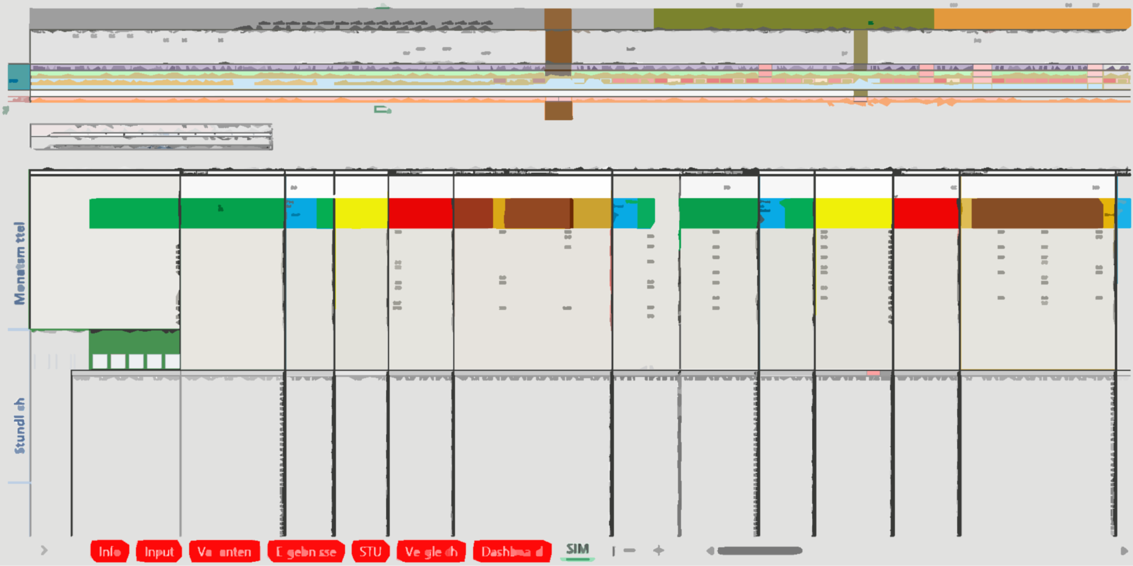

klimaaktiv Deklarationstool
Plus-Energie-Quartiere
A fast one-stop-shop Assessment and Simulation framework for Positive Energy Districts
Simon Schneider¹, Raphael Drexel¹, Thomas Zelger¹, José Baptista²
1 Department of Industrial Engineering, University of Applied Sciences Technikum Wien, Austria, E-Mail: simon.schneider@technikum-wien.at
2 Department of Engineering, School of Science and Technology, University of Trás-os-Montes and Alto Douro, Portugal
Notes:
We present a simulation and assessment framework PEExcel that aims to allow researchers and practitioners to quickly model and assess the primary energy and emission balance of operation, use and mobility of a district beginning in an early planning phase as a decision support system (DSS) for the Austrian klimaaktiv label “climate neutral Positive-Energy-District-”.” (ger. “klimaneutrales Plus-Energie-Quartier”).

Slide 2
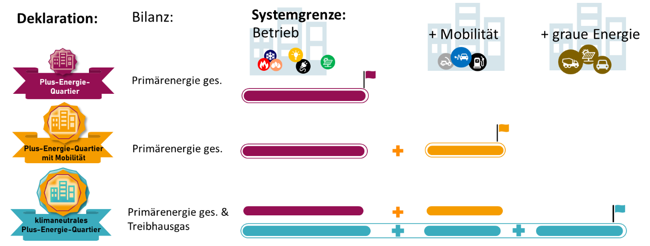

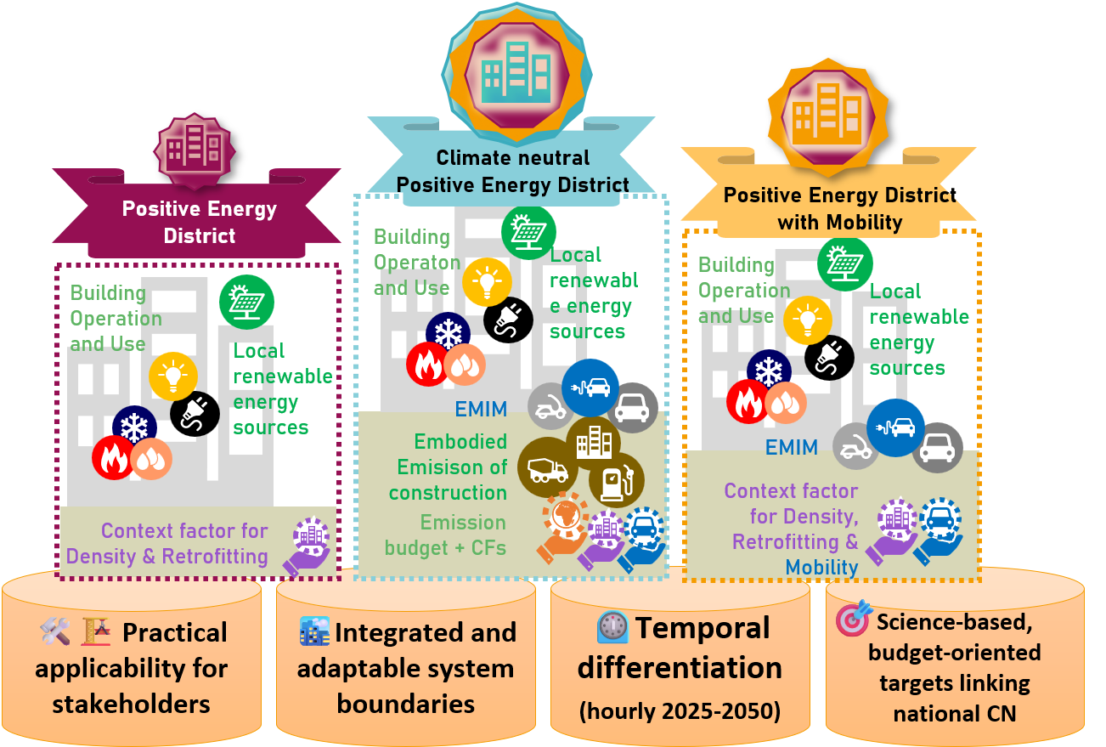

klimaaktiv „Climate Neutral Positive Energy District Declaration“
Latest quantitative declaration of the klimaaktiv national sustainability label (programme line Buildings, Settlements and Districts)
Complements “qualitative” Labels
Provides public Excel simulation/verification tool that yields required primary-energy and GHG balances; fast variant studies, low data burden.
Hourly accounting with dynamic PE/GHG weighting: flexibility (heat pump control, storage, load shifting) changes the balance when it actually helps the system.
Assures wide range applicability of districts: High/low density, urban /rural, greenfield /renovation through Virtual “Context factors” allocate fair, project-specific “budgets” by density, location/mobility and retrofit status (effort-sharing instead of one-size-fits-all).
Climate target coupling: 2 KPIs: 1) positive primary-energy balance (with/without mobility) and 2) a 50-year cumulative GHG budget of ~320kg CO₂e/mGFA.
German Brochure
Preprint: Declaration-Ready Climate-Neutral PEDs: Budget-based, Hourly LCA Including Mobility and Flexibility

Slide 3
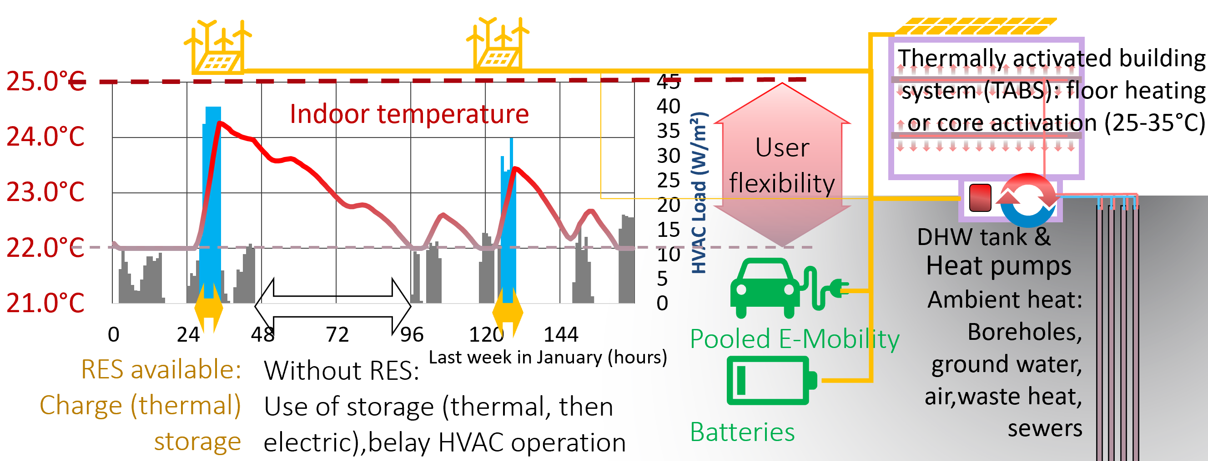
Why?? Simple Energy flexibility and DSM model
Notes:
we wanted a quick way to estimate this for different buildings and districts
and we wanted the assessment analysis quickly as well, meaning Primary Energy balances

Slide 4
The journey so far:
2018: Teaching
„PVWindkraft“-Excel as Simple Teaching tool for flexible integration of RES into district storages (TABS, batteries, Evs)
2019: Exploratory Research
Scenario assessment of 6 Viennese demonstration sites
2019-24: continued development
2024
klima:aktiv Deklarationstool „Klimaneutrale Plusenergiequartiere“
Definition of PED system boundary conditions
Mobility energy model
Scenario batch analysis
2025
Complete re-implementation
Multi-Zone
Multi-Energy-Systems
and the list goes on

Slide 5
Goals of the Assessment framework
Tz: grafisch typische Ergebnisse darstellen
Assessment of PED definition consistent with 100% Renewable Energy and Climate Neutrality 2040
Transient Simulation of all energy flows including e-mobility
Accessibility and transparency
Inclusion of energy flexible control schemes and DSM to increase utilization of volatile RES and increase PED target score
Inclusion of building thermal storage potential to increase utilization of volatile RES and increase PED target score

Slide 6
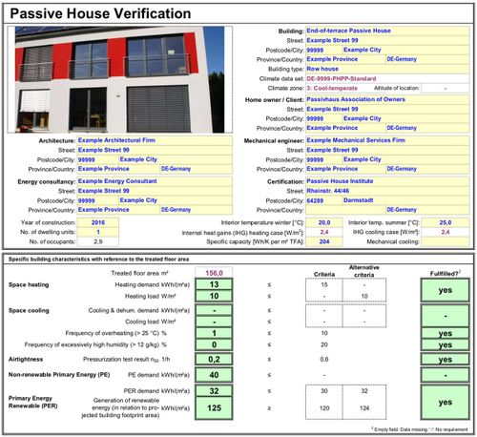

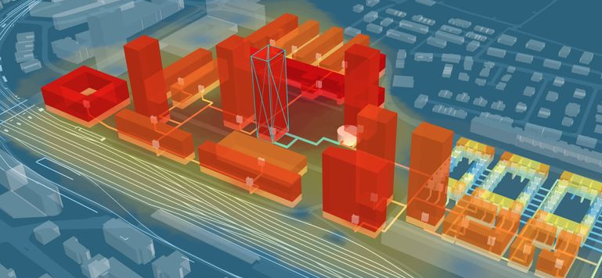
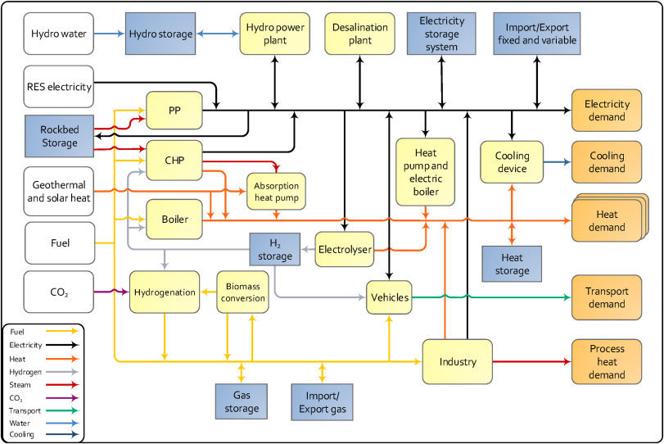
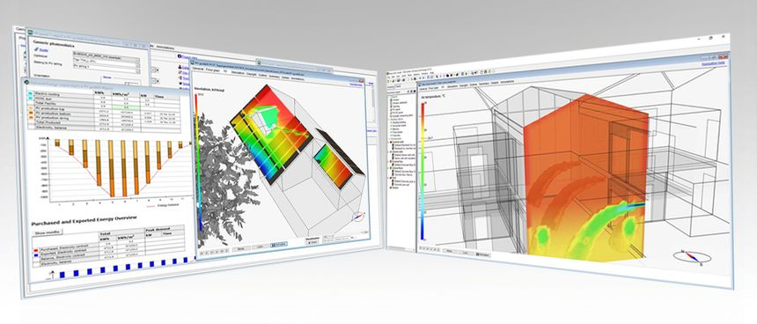
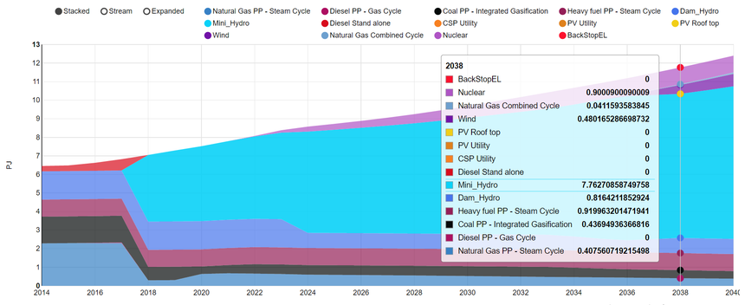
UBEM tension-field and trade-offs
Accessibility and Simplicity
Stationary Methods
DEMs (e.g.CEA)
k:a PED Nachweistool
Extent and Coverage
BEMs (e.g.TRNSYS, IDA-ICE, E+)
Aggregated Frameworks
(e.g. INSEL, EnergyPlan)
Accuracy and Resolution
Notes:
Figure 1 District energy models (DEMs) trade-off between accessibility & simplicity of modeling, accuracy, resolution and speed of simulation results, and coverage of energy services (from HVAC, DHW, plug-loads, mobility to embodied energy)
Positive Energy Districts (PED) represent large and complex systems, whosetheir implementation requires integrated planning in a holistic manner across multiple disciplines and domains (“Ten questions concerning positive energy districts | Elsevier Enhanced Reader,” n.d.). City planners believe that addressing PED implementation challenges in the early conceptual phase through a broad stakeholder commitment approach can help prevent many problems by incorporating these intentions into the master planning directives (Nielsen et al., 2019).
However, it is apparent that for a PED definition focusing on a holistic and integrated energy assessment, including building operation and use, mobility and embodied energy, current dynamic models are unfeasible to deploy in early planning phases (Hedman et al., 2021).
The lack of early integration of energy planning in the district development is mostly due to the lack of data to feed more intricate energy simulation frameworks (Koutra et al., 2018): Even if sufficient data is available and modelling possible, using district simulation models is typically too resource-intensive to deploy early, as the planning will inevitably change in the process, rendering detailed simulation results invalid. On the other hand, simpler decision support systems (DSS) employing stationary methods can lack resolution of key flexibility features of PEDs or lack coverage of all required energy flows.

Slide 7
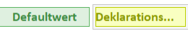
Design principles
Analysis
Modelling
Simulation
Provide defaults values Default scenarios Default energy systems Specific instead of generic
Reduce Resolution Temporal (hourly) Spatial (2-Zone) Logical interconnection
Decrease postprocessing steps Provide a wide variety of analysis options
Increase accessibility of data: reduce number of clicks, etc Increase quality and density of information (visualizations, preformatted reports, etc)

Slide 8

Fossile Energieträger
Stromnetz
Fossil fuels
Strom
Electricity
Electricity Grid
Bilanzierung
Balancing
Externe Erneuerbarer Überschuss
(DSM, Wind-Spitzen)
Netzstrom
Grid
Modell
Offsite Renewable Excess
(DSM, Wind Peaks)
PV Eigenverbrauch
PV direct use
PV Netzeinspeisung
PV feed-in surplus
Flexibler Netzbezug
Flexible grid use
Batterienutzung
Battery use
Wärme
Heat
PV-Strom
E-Car Batterien
PV production
Electric Vehicle
Batteries
Fossile
Fossil fuels
Elektrische
Batterie
Quelle
Source
Battery
Abwärme
Speicher
Storage
Process heat
HT-System
HVAC
System
Warmwasser-
Speicher
Nutzerstrom
Senke
Sink
Gebäudemasse
DHW storage
Plug-loads
Umweltwärme
Building mass
Nutzung
Usage
Ambient heat
Systemgrenze
System Boundary
Umwandlung
Transformation

Slide 9
Priorisierung der Bedarfsdeckung
Prioritization of demand coverage
Bilanzierung Balancing
PV Überschuss
Export
PV Excess
Export
Import
Export
Bedarfe
Demands
Nutzerstrom
HT Minimum
E-Car Minimum
Ladezustand
HT Maximum
E-Car Maximum
Ladezustand
Elektrische Batterie
Plug-loads
HVAC & DHW Minimum
HVAC & DHW
Maximum
Battery
Electric Vehicle
Minimum Charge
Electric Vehicle
Maximum Charge
Deckungen
Supplies
Lokaler PV-Strom
Local PV production
Elektrische Batterie
Flexible Charging of
thermal and electric storages
Battery
Externe Erneuerbarer Überschuss
(DSM, Wind-Spitzen)
Offsite Renewable Excess
(DSM, Wind Peaks)
Stromnetz
Mindestbedärfe gedeckt
Electricity Grid
Minimum demands met
Systemgrenze
System Boundary

Slide 10
Bilanzierung Balancing
Import
Export
Priorisierung der Bedarfsdeckung
Prioritization of demand coverage
Mit🚗bidirektionalem Laden und FlexEinspeisung
PV Überschuss
Export
PV Excess
Export
X= Einspeisesignal (Co2, Preis)
Bedarfe
Demands
Nutzerstrom
HT Minimum
E-Car Minimum
Ladezustand
HT Maximum
E-Car Maximum
Ladezustand
Elektrische Batterie
Plug-loads
HVAC & DHW Minimum
HVAC & DHW
Maximum
Battery
Electric Vehicle
Minimum Charge
Electric Vehicle
Maximum Charge
Deckungen
Supplies
wenn X:0
wenn X:0
wenn X:0
Lokaler PV-Strom
Local PV production
Elektrische Batterie
wenn X>freigabe bat
Battery
Externe Erneuerbarer Überschuss
(DSM, Wind-Spitzen)
wenn X:0
wenn X:0
wenn X:0
wenn X:0
wenn X:0
wenn X:0
Offsite Renewable Excess
(DSM, Wind Peaks)
E-Car Maximum
Ladezustand
wenn X>freigabe bidi EV
Electric Vehicle
Maximum Charge
Stromnetz
Systemgrenze
System Boundary
Electricity Grid
Mindestbedärfe gedeckt
Minimum demands met

Slide 11
Systemgrenze:
Deklaration:
Bilanz:
Betrieb
+ Mobilität
+ graue Energie
Plus-Energie-Quartier
Primärenergie ges.
Plus-Energie-Quartier
mit Mobilität
Primärenergie ges.
Primärenergie ges. & Treibhausgas
klimaneutrales
Plus-Energie-Quartier

Slide 12
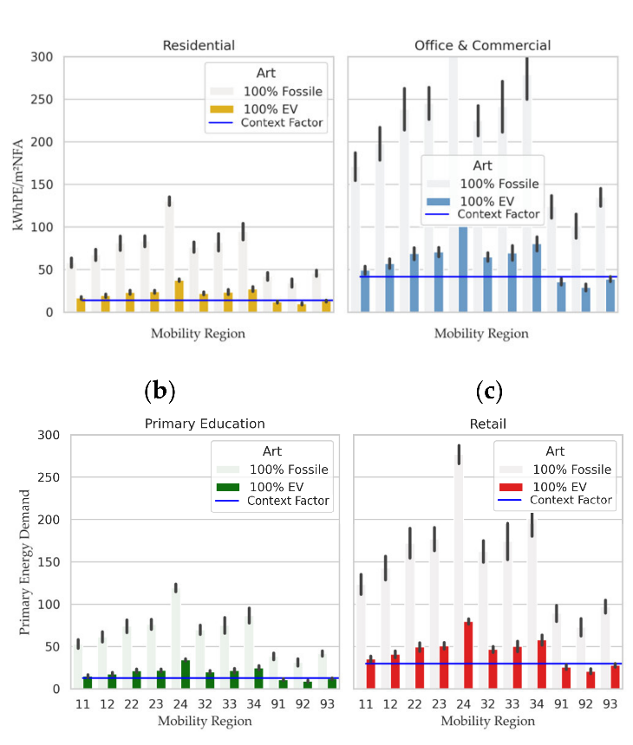
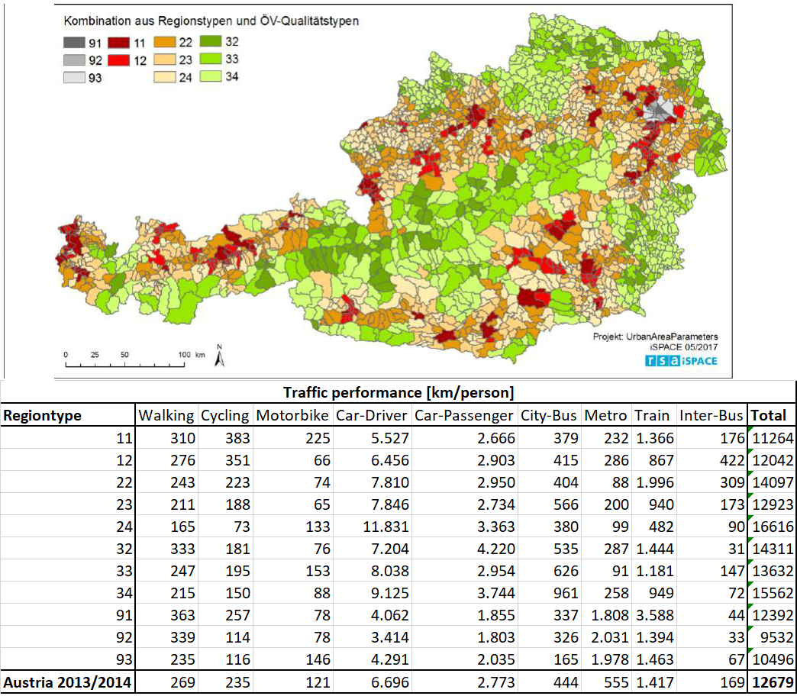
Mobility
Region
Annual Mileage
Destination Mileage per usage
Hourly mobility profile
hourly Energy / Emissions of EMIM
Allocation across Austrian floor area

Slide 13


MOTIVATION & PROBLEM STATEMENT
Transport emissions are rising and must be addressed within energy system transitions.
Positive Energy Districts (PEDs) are emerging as key concepts for decarbonization of the building stock.
Building and District planning can reduce motorized mileage through alternative mobility offers
Electric vehicles (EVs) can support PEDs through storage and load shifting.
Mobility energy and emission impacts should be assessed as part of building and district planning
However, there is a lack of full-year, hourly mobility models at the district level.
Positive Energy District
with mobility
Building
Operation
and Use
Local renewable energy sources
EMIM
Context factor for Density, Retrofitting & Mobility
Annual hourly E-Mobility modelling and assessment in climate neutral Positive Energy Districts
Simon Schneider, University of Applied Sciences Technikum Wien
José Baptista, University of Trás-os-Montes and Alto Douro

Slide 14
OBJECTIVES & RESEARCH QUESTIONS
OBJECTIVE
Develop and apply a full-year hourly EV model to assess energy demand, flexibility, and PV self-utilization in PEDs.
RESEARCH QUESTIONS
What is the expected mobility demand per usage type in a district?
How can (bi-)directional charging be optimized?
How can collective EV behavior be modeled without agent-based simulation?
What is the impact of EV integration on local PV utilization and grid demand?
Annual hourly E-Mobility modelling and assessment in climate neutral Positive Energy Districts
Simon Schneider, University of Applied Sciences Technikum Wien
José Baptista, University of Trás-os-Montes and Alto Douro

Slide 15
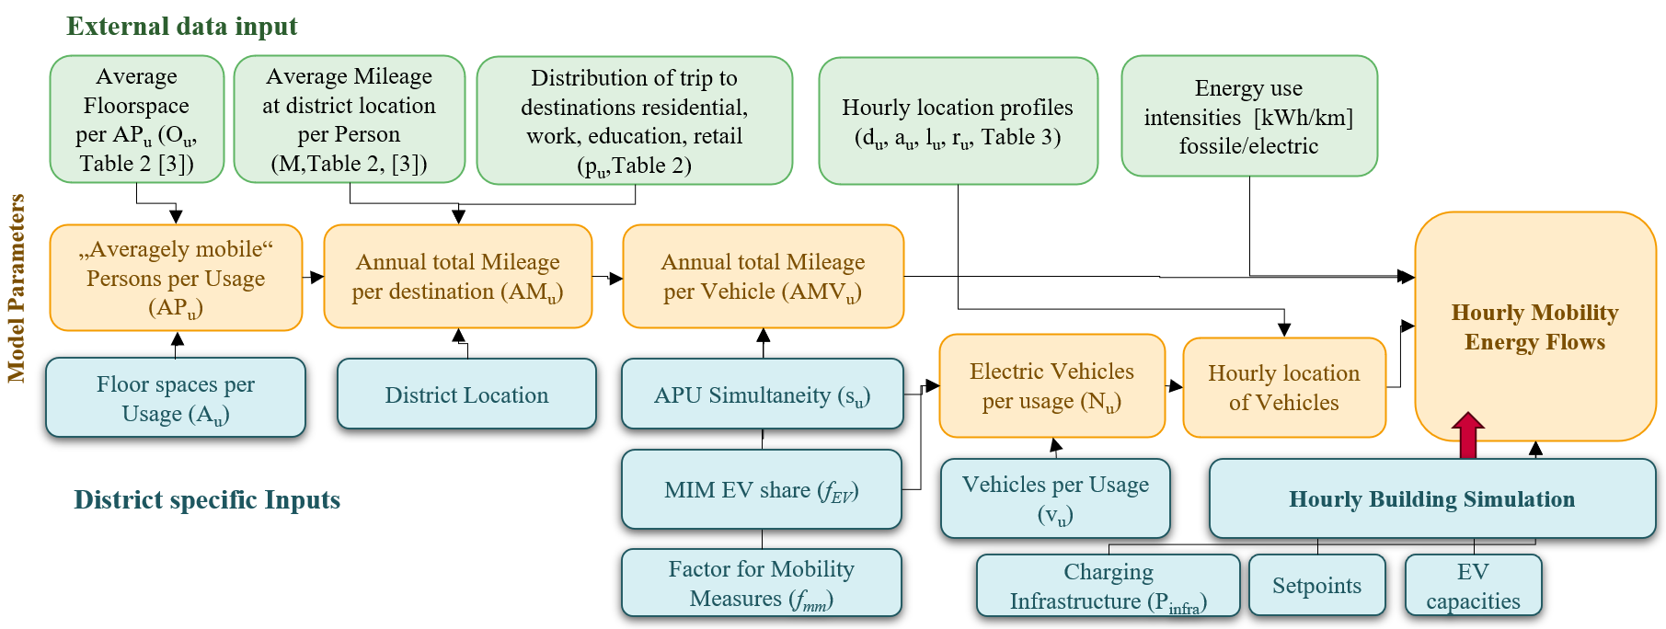
MODEL STRUCTURE & WORKFLOW
Aggregated model: hourly resolution, full year
Usage types:
residential, office, education, retail
Inputs:
floor area,
occupancy,
trip statistics,
vehicle availability
Outputs:
energy demand for mobility,
charging/discharging energy,
SoC profiles
Annual hourly E-Mobility modelling and assessment in climate neutral Positive Energy Districts
Simon Schneider, University of Applied Sciences Technikum Wien
José Baptista, University of Trás-os-Montes and Alto Douro

Slide 16
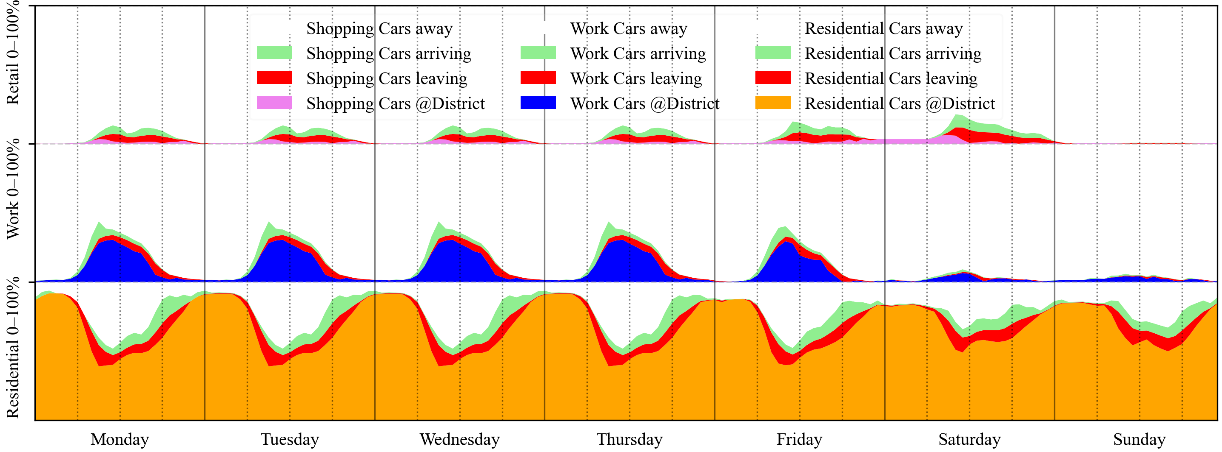
INPUT DATA & ASSUMPTIONS
Sources:
census data,
literature on mileage,
EV shares,
simultaneity
EV presence profiles by hour and usage Key variables:
usable floor area,
average mileage per person,
vehicle density,
simultaneity factors
Charging/discharging logic based on PV availability and regional DSM signals
Hourly probabilities of vehicle presence per usage: residential (orange, bottom), work (blue, middle) or retail/shopping (top, purple). Vehicles “leaving” (red) are considered onsite, switching to offsite at the end of the hour but can still be charged before, “returning” are offsite and arrive at the end of the current hour
Annual hourly E-Mobility modelling and assessment in climate neutral Positive Energy Districts
Simon Schneider, University of Applied Sciences Technikum Wien
José Baptista, University of Trás-os-Montes and Alto Douro

Slide 17
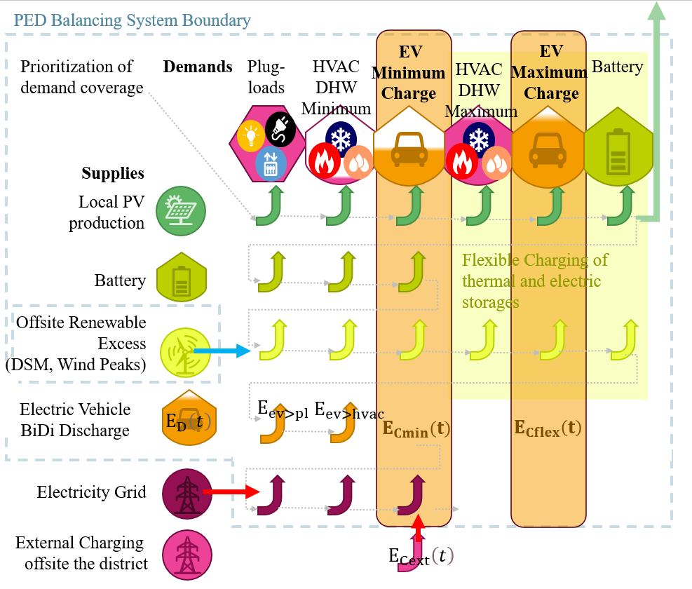
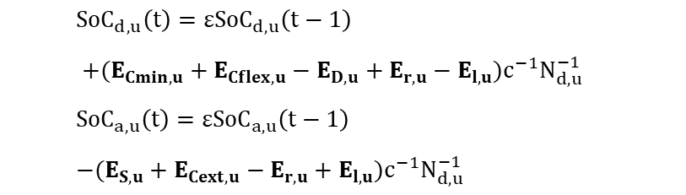
EV OPERATION & BATTERY SOC MODELLING
Hourly tracking of onsite/offsite Evs
Battery SoC evolution (drive discharge, grid charging, PV charging, self-discharge)
Priority: local PV → local battery → regional RES → grid
Bi-directional charging logic based on minimum SoC and building demand
$${SoC}_{d,u}\left(t\right)={εSoC}_{d,u}\left(t−1\right)$$ $+(E_{Cmin,u}+E_{Cflex,u}−E_{D,u}+E_{r,u}−E_{l,u}){c^{−1}N}_{d,u}^{−1}$
$${SoC}_{a,u}\left(t\right)={εSoC}_{a,u}\left(t−1\right)$$ $−(E_{S,u}+E_{Cext,u}−E_{r,u}+E_{l,u}){c^{−1}N}_{d,u}^{−1}$
Annual hourly E-Mobility modelling and assessment in climate neutral Positive Energy Districts
Simon Schneider, University of Applied Sciences Technikum Wien
José Baptista, University of Trás-os-Montes and Alto Douro

Slide 18
USE CASE SETUP & SCENARIOS
Four use cases with same building size:
10 single-family homes (SFH)
Office
School
Supermarket
Parameters:
EV shares,
PV sizing,
simultaneity,
gross floor area
Variation in vehicle presence, charging potential, and energy flexibility
Table: Key parameters per use case
Variable | 10 SFHs | Office | School | Super-market
Gross floor area (m²) | 10x 240 | 2 400 | 2 400 | 2 400
Storeys | 2 | 1 | 1 | 1
Unique visiting EVs | 19 | 115 | 58 | 408
Vehicles per Area (1/100m²) | 1 | 10 | 10 | 20
EV Share | 100% | 100% | 30% | 100%
Hourly EV Simultaneity | 73% | 10.1% | 10.1% | 3.4%
Min/Average /Max EVs per hour | 9/14/18 | 0/12/40 | 0/5.8/58 | 0/14/49
Averagely mobile People | 46 | 305 | 768 | 191
Annual EV Mileage (mio km) | 0.44 | 2.97 | 0.9 | 1.74
PV (kWp) =100kWh/m²NFA | 200 | 200 | 200 | 200
Flexible Grid use (up to x kW) | 0 | 96 | 96 | 96
Annual hourly E-Mobility modelling and assessment in climate neutral Positive Energy Districts
Simon Schneider, University of Applied Sciences Technikum Wien
José Baptista, University of Trás-os-Montes and Alto Douro

Slide 19
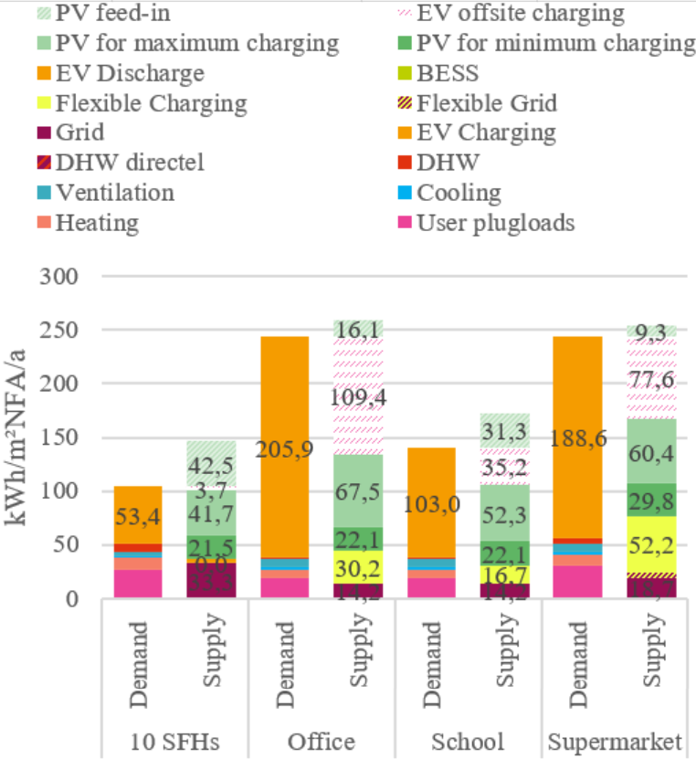
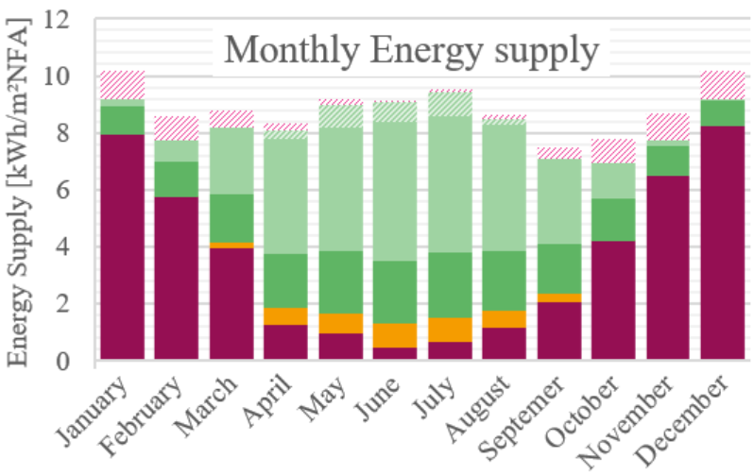
SIMULATION RESULTS
HIGHLIGHTS
EV mobility demand: 53–205 kWh/m²a
PV self-utilization increased up to 90% in non-residential cases
Bi-directional charging reduces grid demand by up to 28%
Full equivalent cycles increase by 20%
Annual hourly E-Mobility modelling and assessment in climate neutral Positive Energy Districts
Simon Schneider, University of Applied Sciences Technikum Wien
José Baptista, University of Trás-os-Montes and Alto Douro

Slide 20
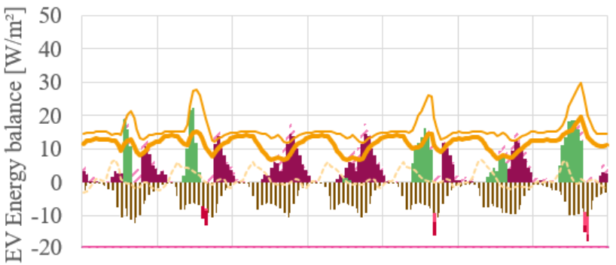
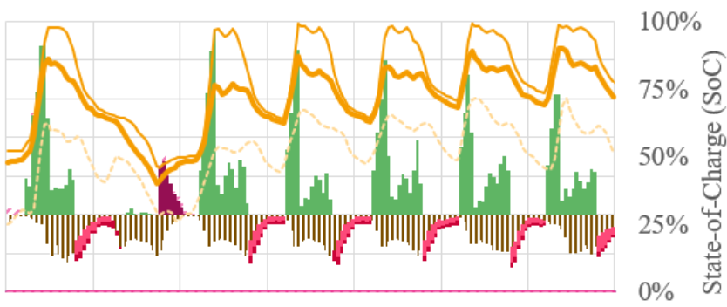
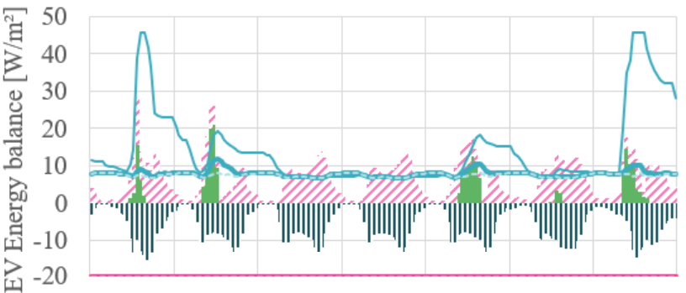
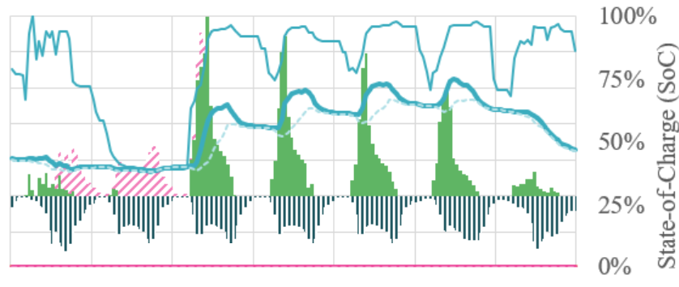
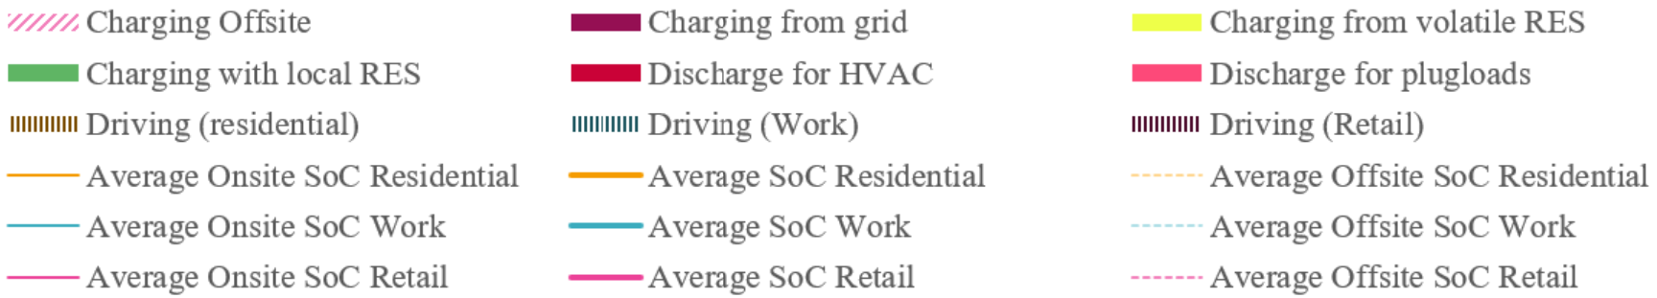
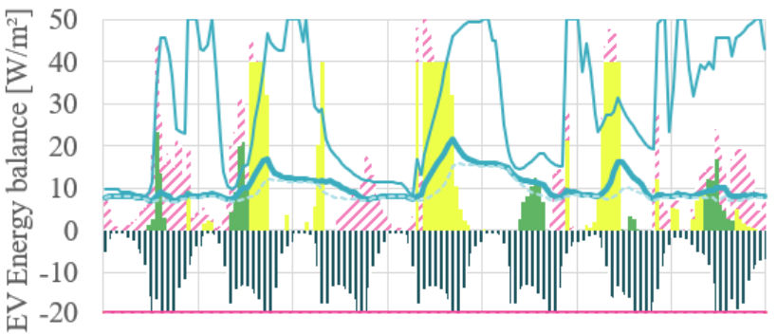
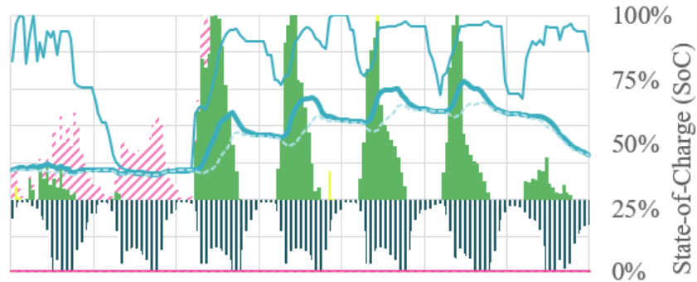
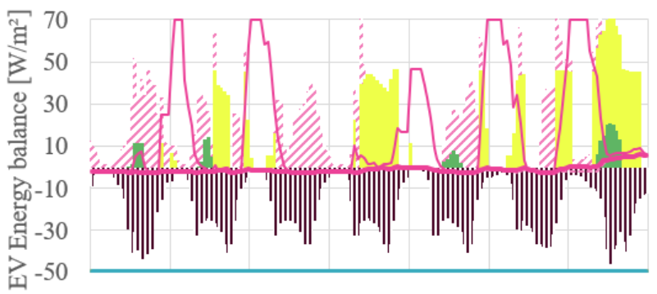
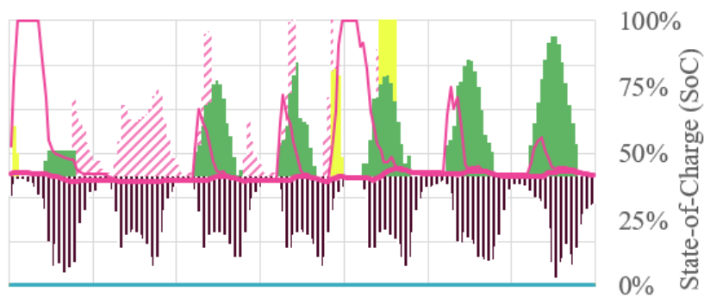
SIMULATION RESULTS c/d
Hourly mobility energy balance (left axis) and EV SoC (right axis) for four example usages residential (top, orange), office (second, blue), school (second to last, blue), supermarket (bottom, pink) for a week in winter (28.January.-3.February., left) and summer (8.-15.July, left)
Annual hourly E-Mobility modelling and assessment in climate neutral Positive Energy Districts
Simon Schneider, University of Applied Sciences Technikum Wien
José Baptista, University of Trás-os-Montes and Alto Douro

Slide 21
Discussion / Model limits
Temporal resolution
Hourly
Multivalent Enegy systems
under construction
Simulation speed and coverage
10s/scenario on laptops
Accessibility / deployment
Fair!
Algorithm programming with VBA
Gamechanger ChatGPT
Thermal LOD
low
Geometry LOD
low
Managing file size
Challenging!
Dispatch sequence
fixed
Testing and validation
Nightmare!

Slide 22
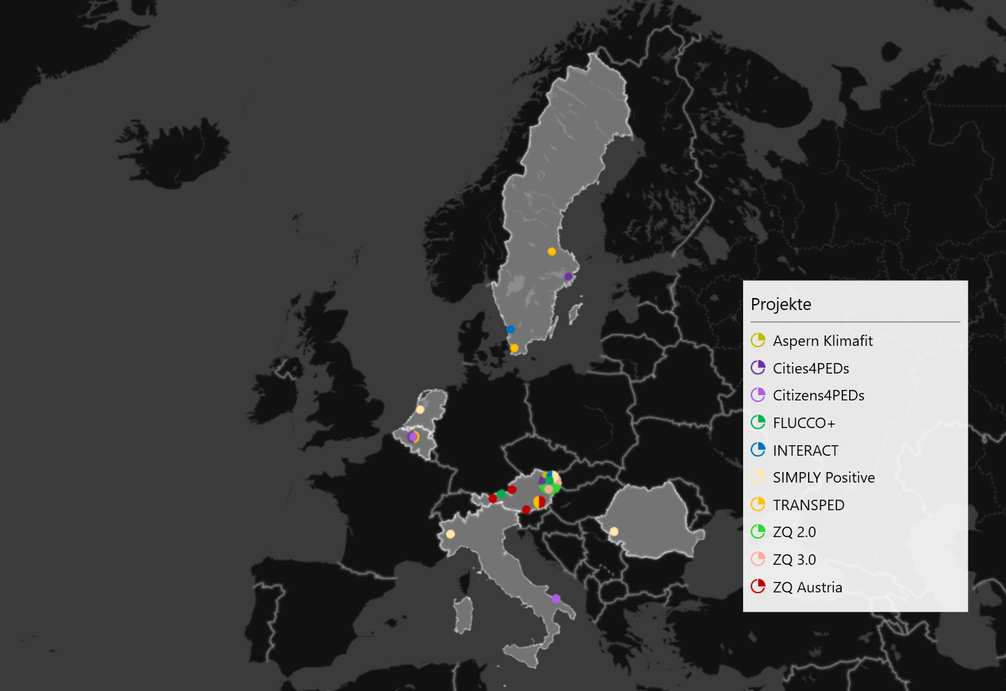
40+ Districts investigated in 15+ research projects

Slide 23
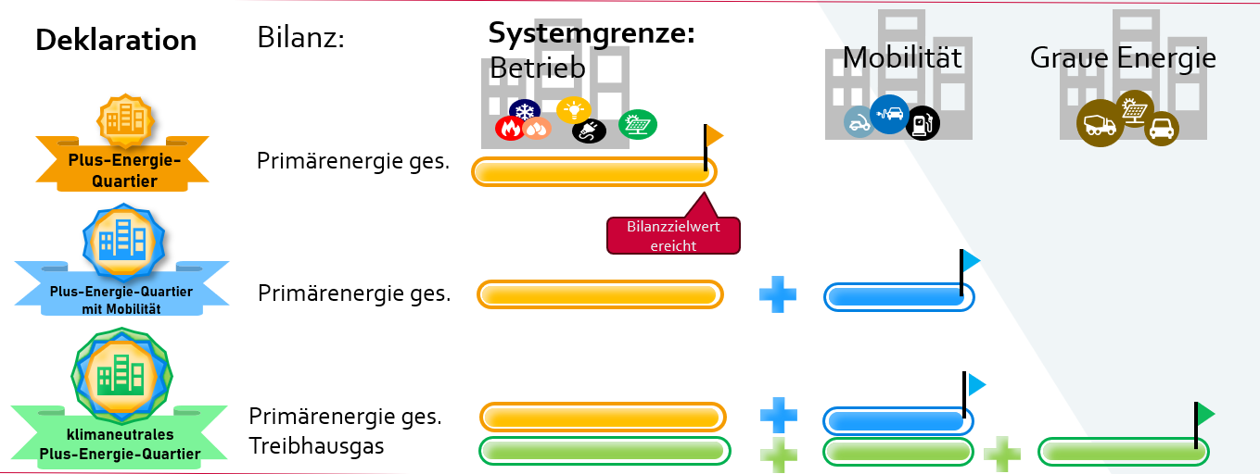



klima:aktik klimaneutrale Plusenergiequartiere
Research
SdZ Zukunftsquartier 2.0 (finished)
Zukunftsquartier (finished)
Zukukunftsquartier Österreich (finished)
Zukunftsquartier Synergy (finished)
ZQ3 (ongoing), k:a PEQ (ongoing)
Theoretical PED Definition framework
S. Schneider, N. Bartlmä, J. Leibold, P. Schöfman, M. Tabakovic, und T. Zelger, „New Assessment Method for Buildings and Districts towards “Net Zero Energy Buildings” Compatible with the Energy Scenario 2050“, gehalten auf der REAL CORP, Karlsruhe, 2019. [Online]. Verfügbar unter: http://repository.corp.at/id/eprint/487
The PEExcel PED DSS framework: https://github.com/simonschaluppe/peexcel

Slide 24
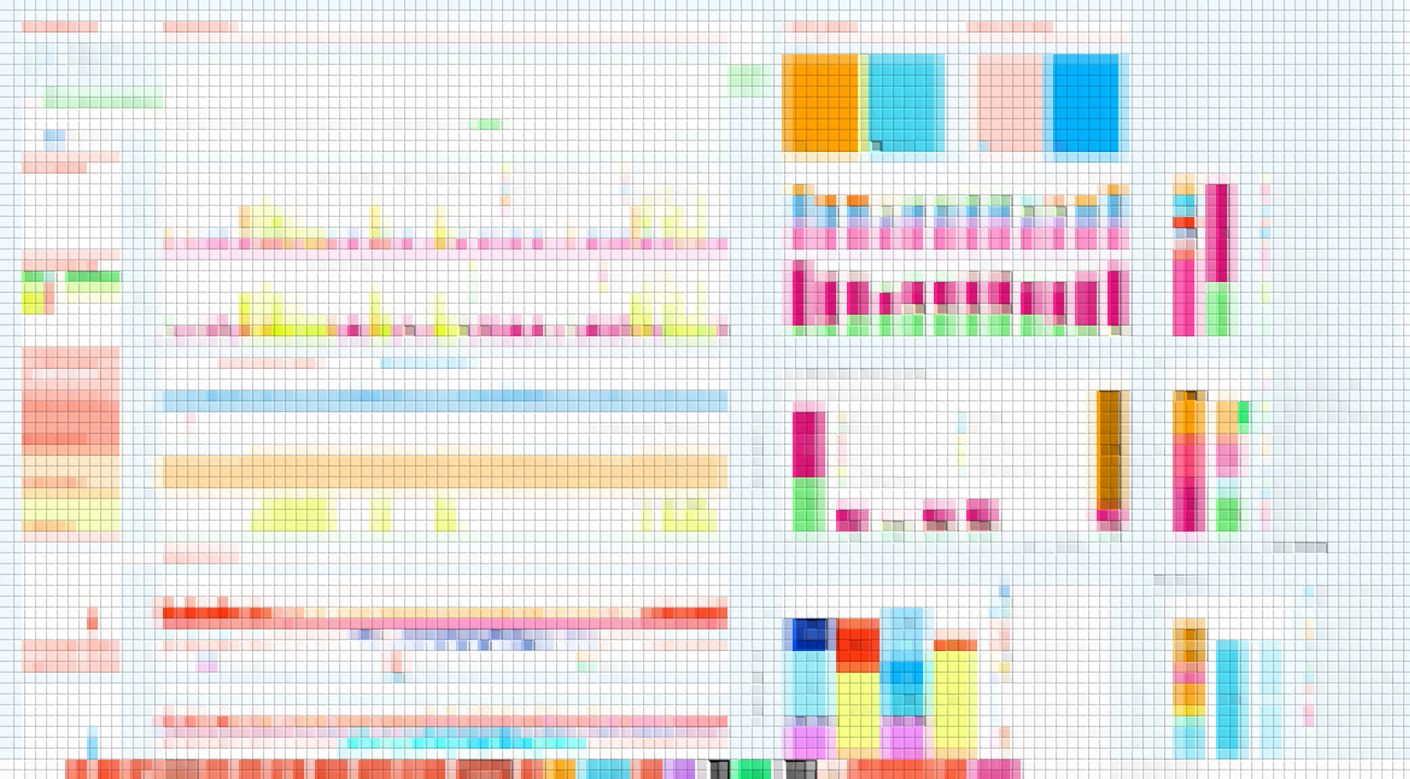

Slide 25
Tool Überblick
Simulation 8760 h
Ergebnisablage
Ausgabe
Parametrisierung
Eingabeblätter
▶️ - Überblick
🏙️ - Quartier
🌦️ - Wetter
🧱 - Bauphysik
🔥 H - Heizung
❄️K - Kühlung
💨L - Lüftung
💧WW
🌞PV
Pvimport
🔋 - Speicher
🚗 Mobilität
☁ Treibhauspotential
🏆 PEQ
🏆 PEQ+M
🏆 KN PEQ
👤P
👤Zeitreihen (ZR)
⚖ Gewichtung
🚗Ecars
⚙ Parameter
RANGES
Bauteile
Mobilität
IN ~700 Variablen je Variante / Szenario
SIM2 330 Zeitreihen 2-Zonen Modell
OUT ~300 Ergebnisse je Variante / Szenario

Slide 26
📊 Benutzerdefiniertes Excel-Ribbon
Eingabe Navigation & Bedienung
📂 Laden
💾 Speichern
Analyse und Ergebnisse
Deklarations-nachweise
Implementierungs-Details
📂 Laden von Varianten und Eingaben
Schaltfläche „Laden“ (in der Gruppe Varianten):
Erlaubt das einfache Umschalten zwischen verschiedenen Eingabekonfigurationen oder Szenarien.
Keine manuelle Auswahl im Tabellenblatt erforderlich – alles direkt im Ribbon.
💾 Speichern & Projektstruktur
Trennung von Projekt und Szenario:
Projekte enthalten mehrere Szenarien.
Szenarien können einzeln geladen, gespeichert oder dupliziert werden.
Speicherfunktionen im Ribbon:
Speichern von Szenarien unter neuem Namen.
Export-/Importfunktionen (z. B. als separate Datei oder JSON/XML je nach Implementierung).

Slide 27
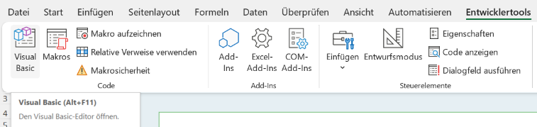
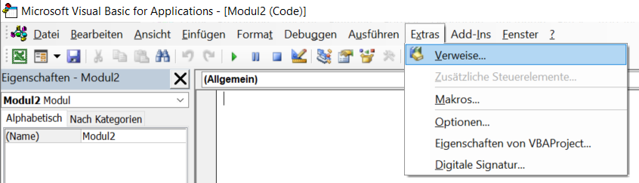
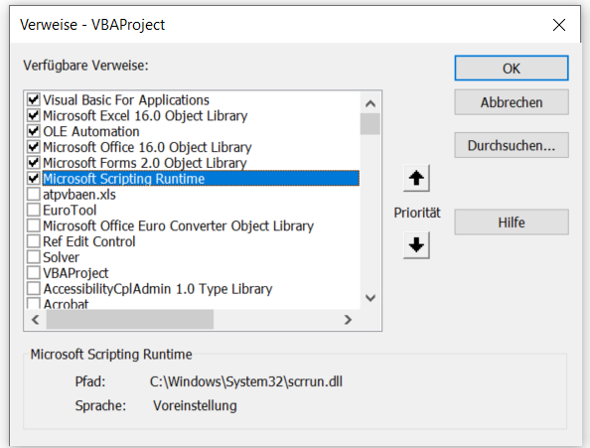



VBA Troubleshoot
Fehlende Verweise abhaken /dekativieren

Slide 28
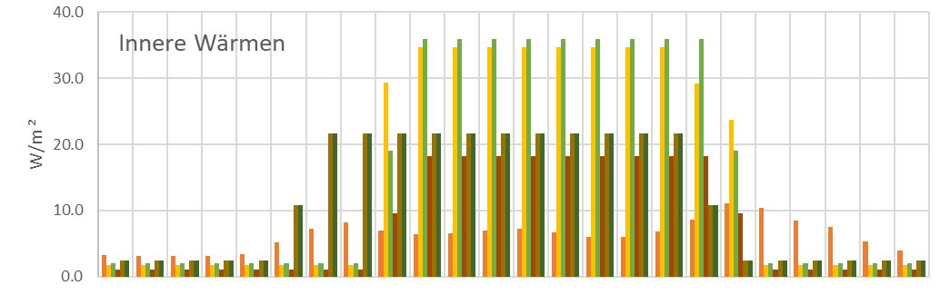
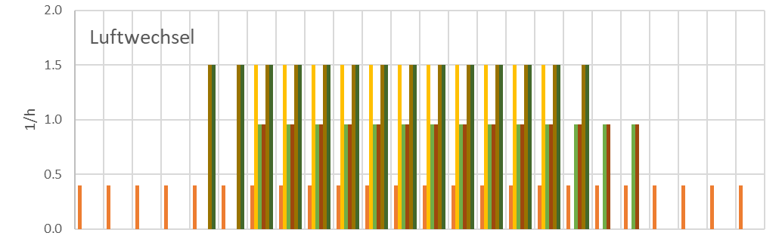
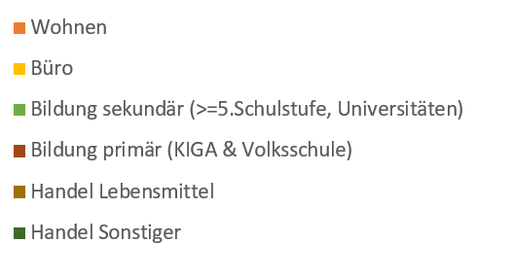
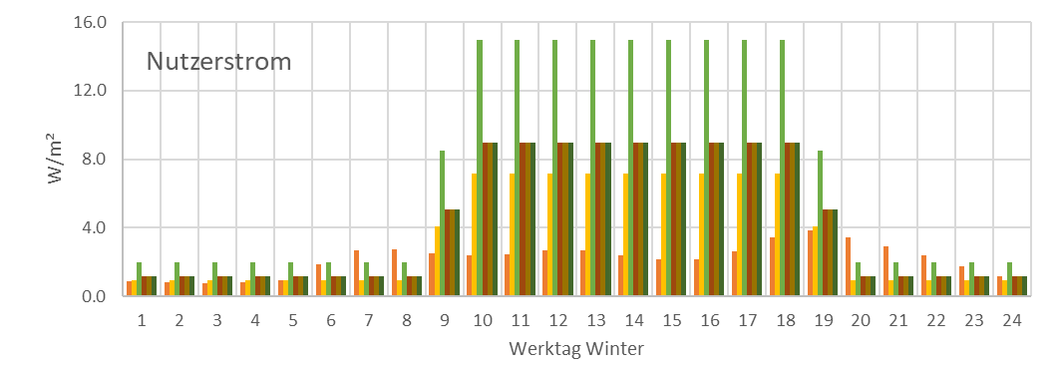
Nutzung
Innere Lasten
Bedarf an Luftwechsel
Nutzerstrom (+ Beleuchtung)

Slide 29
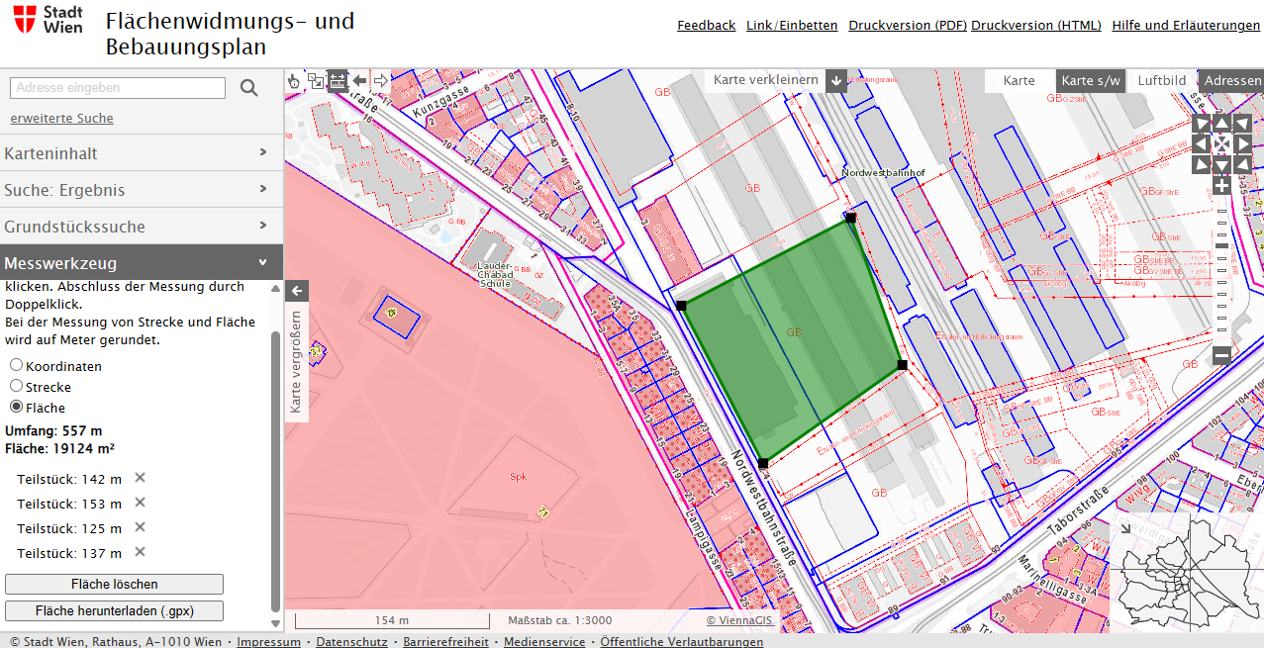
Grundstücksfläche

Slide 30
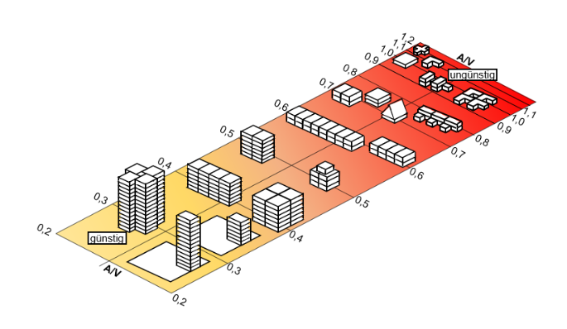
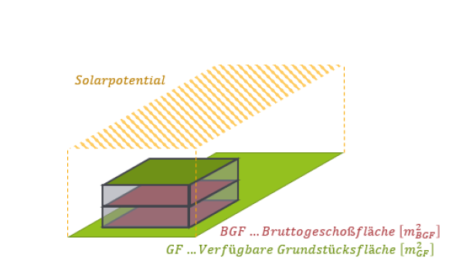
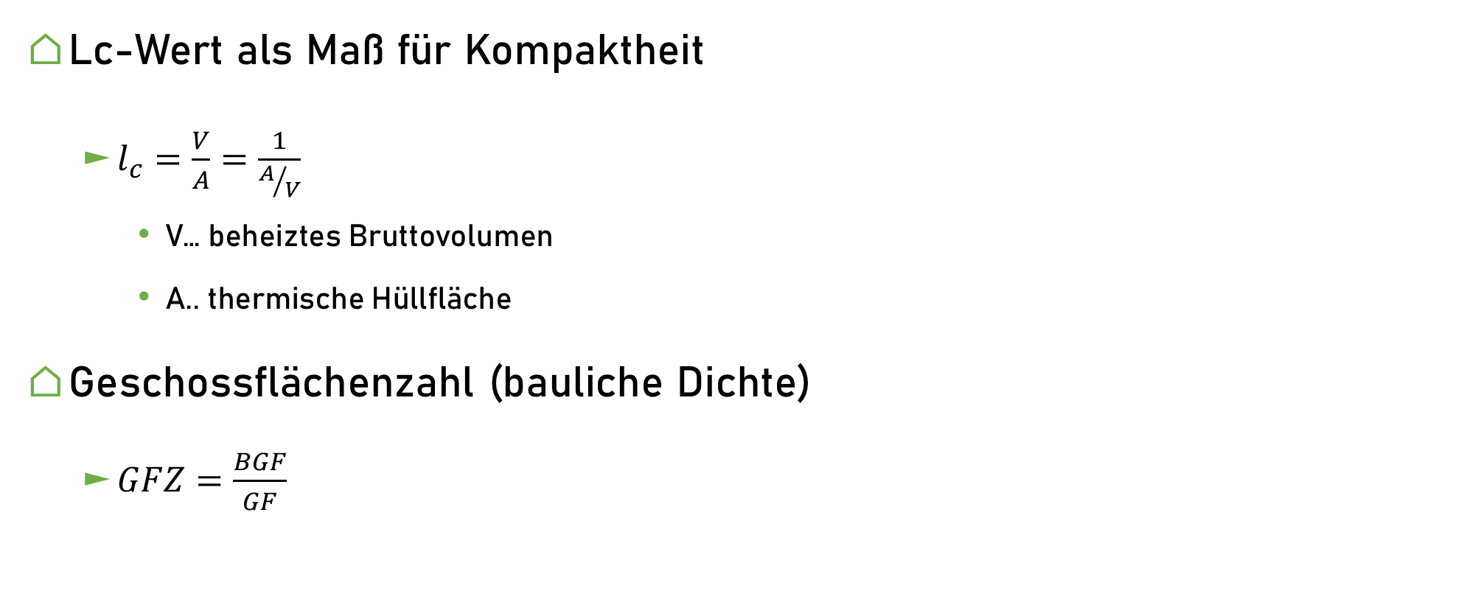
Photovoltaik – Kompaktheit und bauliche Dichte
Lc-Wert als Maß für Kompaktheit
$l_{c}=\frac{V}{A}=\frac{1}{A/V}$
V… beheiztes Bruttovolumen
A.. thermische Hüllfläche
Geschossflächenzahl (bauliche Dichte)
$GFZ=\frac{BGF}{GF}$
Quelle: Solarfibel Baden-Württemberg 2002
Quelle: Whitepaper PEQ Definition und Operationalisierung

Slide 31
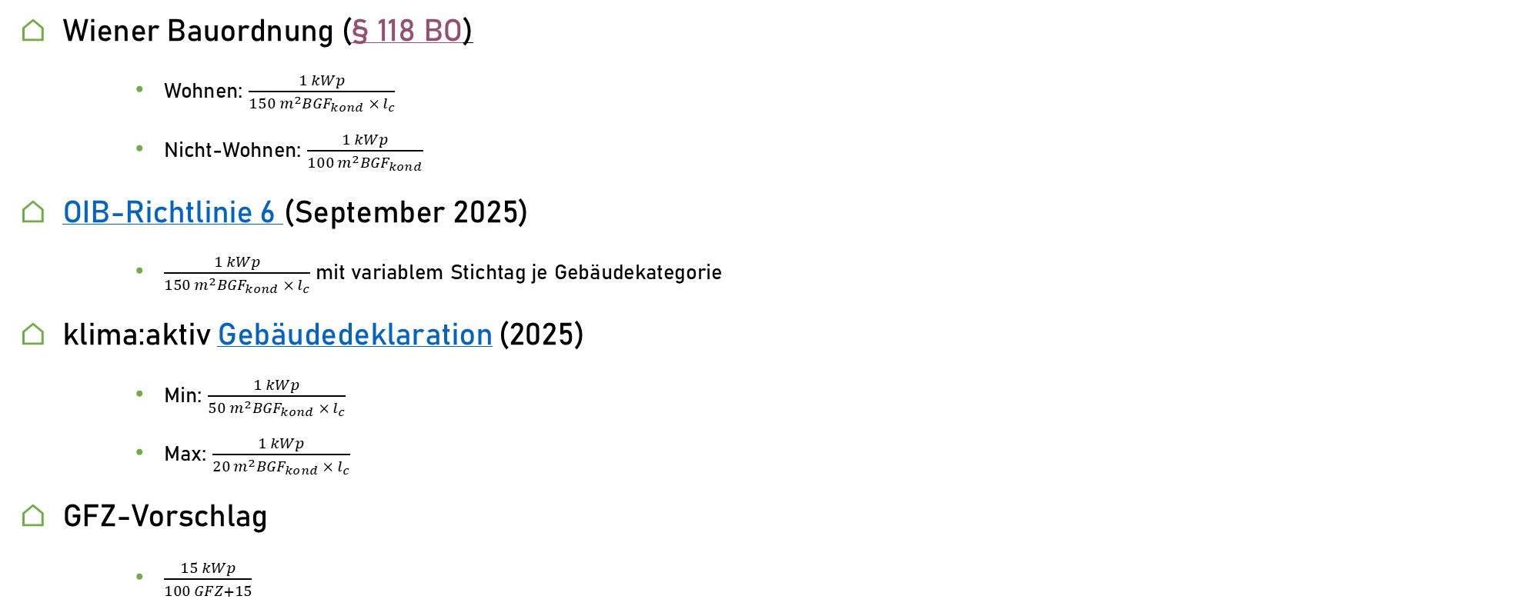
Photovoltaik in Verordnungen und Leitfäden
Wiener Bauordnung (§ 118 BO)
Wohnen: $\frac{1 kWp}{150 m^{2}{BGF}_{kond} × l_{c}}$
Nicht-Wohnen: $\frac{1 kWp}{100 m^{2}{BGF}_{kond}}$
OIB-Richtlinie 6 (September 2025)
$\frac{1 kWp}{150 m^{2}{BGF}_{kond} × l_{c}}$ mit variablem Stichtag je Gebäudekategorie
klima:aktiv Gebäudedeklaration (2025)
Min: $\frac{1 kWp}{50 m^{2}{BGF}_{kond} × l_{c}}$
Max: $\frac{1 kWp}{20 m^{2}{BGF}_{kond} × l_{c}}$
GFZ-Vorschlag
$\frac{15 kWp}{100 GFZ+15}$
Notes:
OIB: Ab Jänner 2027 Neue Öffentliche, neue Ni-Wo, neue Sonstige
Ab 2028 bestehende Öffentliche
Ab 2028 Ni-Wo i.Z.d. Sanierung (energetisch)
Ab 2030 neue Wo

Slide 32
User-Inputs
💧 | Temperatur Minimum
💧 | Temperatur Maximum Eingabe
💧 | Warmwasser System 1 Anteil Wohnen
💧 | Warmwasser System 1 Anteil Büro
💧 | Warmwasser System 1 Anteil Schule sekundär
💧 | Warmwasser System 1 Anteil Schule primär
💧 | Warmwasser System 1 Anteil Handel Lebensmittel
💧 | Warmwasser System 1 Anteil Handel Sonstige
💧 | Warmwasser System 1 Anteil Sonstige Nutzung
💧 | Warmwasser Verluste: Speicher1
💧 | Warmwasser Verluste: Speicher2
💧 | Warmwasser Verluste: Wirkungsgrad Verteilsystem 1
💧 | Warmwasser Verluste: Wirkungsgrad Verteilsystem 2
💧 | Warmwasser System 1 Energieträger
💧 | Warmwasser System 2 Energieträger
💧 | Warmwasser System 1 Wirkungsgrad
💧 | Warmwasser System 2 Wirkungsgrad
📝 | Projektname
📝 | ProjektURL
🧭 | Adresse
🧭 | Gemeinde
📝 | Erstellungsdatum
📝 | Projektbeschreibung
📝 | Variante / Scenario
🧭 | Postleitzahl
 | Name | m² BGF | NGF/BGF | Sanierungsanteil
🏙️ | Wohnen
🏙️ | Büro
🏙️ | Bildung sekundär
🏙️ | Bildung primär
🏙️ | Lebensmittelhandel
🏙️ | Handel sonstiger
🏙️ | Sonstige
🏙️ | Bebaubare Grundstücksfläche
💨 | Luftdichtheit n50
💨 | Mechanische Lüftung Wohnen
💨 | Mechanische Lüftung Büro
💨 | Mechanische Lüftung Bildung sekundär
💨 | Mechanische Lüftung Bildung primär
💨 | Mechanische Lüftung Handel Lebensmittel
💨 | Mechanische Lüftung Handel sonstiger
💨 | Mechanische Lüftung Sonstige Nutzung
💨 | Nachtauskühlung Fensterstellung Wohnen
💨 | Nachtauskühlung Fensterstellung Büro
💨 | Nachtauskühlung Fensterstellung Bildung sekundär
💨 | Nachtauskühlung Fensterstellung Bildung primär
💨 | Nachtauskühlung Fensterstellung Handel Lebensmittel
💨 | Nachtauskühlung Fensterstellung Handel sonstiger
💨 | Nachtauskühlung Fensterstellung Sonstige Nutzung
💨 | Luftwechsel Wohnen
💨 | Luftwechsel Büro
💨 | Luftwechsel Bildung sekundär
💨 | Luftwechsel Bildung primär
💨 | Luftwechsel Handel Lebensmittel
💨 | Luftwechsel Handel sonstiger
💨 | Luftwechsel Sonstige Nutzung
💨 | Lüfterstrom mech. Wohnen
💨 | Lüfterstrom mech. Büro
💨 | Lüfterstrom mech. Bildung sekundär
💨 | Lüfterstrom mech. Bildung primär
💨 | Lüfterstrom mech. Handel Lebensmittel
💨 | Lüfterstrom mech. Handel sonstiger
💨 | Lüfterstrom mech. Sonstige Nutzung
💨 | Wärmerückgewinnung Winter Wohnen
💨 | Wärmerückgewinnung Winter Büro
💨 | Wärmerückgewinnung Winter Bildung sekundär
💨 | Wärmerückgewinnung Winter Bildung primär
💨 | Wärmerückgewinnung Winter Handel Lebensmittel
💨 | Wärmerückgewinnung Winter Handel sonstiger
💨 | Wärmerückgewinnung Winter Sonstige Nutzung
💨 | Wärmerückgewinnung Sommer Wohnen
💨 | Wärmerückgewinnung Sommer Büro
💨 | Wärmerückgewinnung Sommer Bildung sekundär
💨 | Wärmerückgewinnung Sommer Bildung primär
💨 | Wärmerückgewinnung Sommer Handel Lebensmittel
💨 | Wärmerückgewinnung Sommer Handel sonstiger
💨 | Wärmerückgewinnung Sommer Sonstige Nutzung
💨 | Wärmerückgewinnung Übergangszeit Wohnen
💨 | Wärmerückgewinnung Übergangszeit Büro
💨 | Wärmerückgewinnung Übergangszeit Bildung sekundär
💨 | Wärmerückgewinnung Übergangszeit Bildung primär
💨 | Wärmerückgewinnung Übergangszeit Handel Lebensmittel
💨 | Wärmerückgewinnung Übergangszeit Handel sonstiger
💨 | Wärmerückgewinnung Übergangszeit Sonstige Nutzung
🔋 | Flex PV Nutzung
🔋 | Flex Signal Nutzung
🔋 | Flex Signal Name
🔋 | Flex Maximale Leistung | W/m²
🔋 | Flex Netzbezug deckt Nutzerstrom | bool
🔋 | Flex Netzbezug deckt HVAC Minimum | bool
🔋 | Flex Netzbezug deckt EV Minimum | bool
🔋 | Batterie Nutzung
🔋 | Batterie Kapazität | kWh
🔋 | Maximale Be/Entladeleistung | %
🔋 | Wirkungsgrad Ladung | %
🔋 | Wirkungsgrad Entladung | %
🔋 | Batterie Selbstentladung | %/h
🔋 | Batterie wird flexibel durch Netz geladen? | bool
❄️ | Kühlperiode Jänner | Bool
❄️ | Kühlperiode Februar | Bool
❄️ | Kühlperiode März | Bool
❄️ | Kühlperiode April | Bool
❄️ | Kühlperiode Mai | Bool
❄️ | Kühlperiode Juni | Bool
❄️ | Kühlperiode Juli | Bool
❄️ | Kühlperiode August | Bool
❄️ | Kühlperiode September | Bool
❄️ | Kühlperiode Oktober | Bool
❄️ | Kühlperiode November | Bool
❄️ | Kühlperiode Dezember | Bool
❄️ | Aktive Kühlung Anteil Wohnen
❄️ | Aktive Kühlung Anteil Büro
❄️ | Aktive Kühlung Anteil Schule sekundär
❄️ | Aktive Kühlung Anteil Schule primär
❄️ | Aktive Kühlung Anteil Handel Lebensmittel
❄️ | Aktive Kühlung Anteil Handel Sonstige
❄️ | Aktive Kühlung Anteil Sonstige Nutzung
❄️ | spez. thermische Leistung Aufnahmesystem | W/m²
❄️ | Thermische Leistung Freecooling | W/m²
❄️ | Thermische Leistung 1 EL | W/m²
❄️ | Thermische Leistung 2 TH | W/m²
❄️ | Thermische Leistung 3 EL | W/m²
❄️ | Verteilverluste Freecooling | W/m²
❄️ | Verteilverluste 1 El
❄️ | Verteilverluste 2th
❄️ | Verteilverluste 3el
❄️ | Wirkungsgrad Erzeugung 1 El
❄️ | Wirkungsgrad Erzeugung 2 TH
❄️ | Wirkungsgrad Erzeugung 3 EL
❄️ | Hilfsstromanteil Freecooling
❄️ | Hilfsstromanteil KLEL1
❄️ | Hilfsstromanteil KLTh2
❄️ | Hilfsstromanteil KLEL3
❄️ | Energieträger System 2 Thermisch
❄️ | Kühlen Solltemperatur Maximum | °C
🧱 | U-Wert Außenwände | W/m²K
🧱 | U-Wert Dach | W/m²K
🧱 | U-Wert Kellerdecke / Fundament | W/m²K
🧱 | U-Wert Fenster Nord | W/m²K
🧱 | U-Wert Fenster Ost | W/m²K
🧱 | U-Wert Fenster Süd | W/m²K
🧱 | U-Wert Fenster West | W/m²K
🧱 | U-Wert Fenster Horizontal | W/m²K
🧱 | Wärmebrückenzuschlag
♨️ | Heizperiode Jänner | Bool
♨️ | Heizperiode Februar | Bool
♨️ | Heizperiode März | Bool
♨️ | Heizperiode April | Bool
♨️ | Heizperiode Mai | Bool
♨️ | Heizperiode Juni | Bool
♨️ | Heizperiode Juli | Bool
♨️ | Heizperiode August | Bool
♨️ | Heizperiode September | Bool
♨️ | Heizperiode Oktober | Bool
♨️ | Heizperiode November | Bool
♨️ | Heizperiode Dezember | Bool
♨️ | spez. thermische Leistung Abgabesystem | W/m²
♨️ | Thermische Leistung HZEL1 | W/m²
♨️ | Thermische Leistung HZTH2 | W/m²
♨️ | Thermische Leistung HZEL3 | W/m²
♨️ | Thermische Leistung HZTH4 | W/m²
♨️ | Verteilverluste HZEL1
♨️ | Verteilverluste HZTH2
♨️ | Verteilverluste HZEL3
♨️ | Verteilverluste HZTH4
♨️ | Wirkungsgrad Erzeugung HZEL1
♨️ | Wirkungsgrad Erzeugung HZTH2
♨️ | Wirkungsgrad Erzeugung HZEL3
♨️ | Wirkungsgrad Erzeugung HZTH4
♨️ | Hilfsstromanteil HZEL1
♨️ | Hilfsstromanteil HZTH2
♨️ | Hilfsstromanteil HZEL3
♨️ | Hilfsstromanteil HZTH4
♨️ | Energieträger HZTH2
♨️ | Energieträger HZTH4
♨️ | Heizen Raumtemperatur Minimum | °C
♨️ | Flexibles Heizen über Solltemperatur
♨️ | Flexibles Heizsystem | Text
🚗 | MIV simulieren | bool
🚗 | Stellplätze | Anzahl
🚗 | Fahrzeuge | Anzahl
🚗 | Anteil-Ecars | %
🚗 | Ecar Energieverbrauch | kWh/km
🚗 | Ecar Speicher pro Fahrzeug | kWh/EV
🚗 | Ecar Selbstentladung wöchentlich | %/Woche
🚗 | Ecar Mindest-Speicherstand | %
🚗 | Ecar Batterie-Effizienz Beladung | %
🚗 | Ecar Batterie Maximale Beladungsleistung | %
🧊 | Hüllfläche Außenwand | m² Brutto
🧊 | Hüllfläche Dach | m² Brutto
🧊 | Hüllfläche Kellerdecke / Fundament | m² Brutto
🧊 | Hüllfläche Fenster Nord | m² Brutto
🧊 | Hüllfläche Fenster Ost | m² Brutto
🧊 | Hüllfläche Fenster Süd | m² Brutto
🧊 | Hüllfläche Fenster West | m² Brutto
🧊 | Hüllfläche Fenster Horizontal | m² Brutto
🏢 | g-Wert Fenster Nord
🏢 | g-Wert Fenster Ost
🏢 | g-Wert Fenster Süd
🏢 | g-Wert Fenster West
🏢 | g-Wert Fenster Horizontal
🏢 | Einstrahlungsfaktor Fenster Nord
🏢 | Einstrahlungsfaktor Fenster Ost
🏢 | Einstrahlungsfaktor Fenster Süd
🏢 | Einstrahlungsfaktor Fenster West
🏢 | Einstrahlungsfaktor Fenster Horizontal
🏢 | Faktor Sommer Nord
🏢 | Faktor Sommer Ost
🏢 | Faktor Sommer Süd
🏢 | Faktor Sommer West
🏢 | Faktor Sommer Horizontal
🏢 | Mobiler Sonnenschutz Fc-Wert
☁ | GWP Baustoffe Außenwand | GWP 100S (kg_{CO2equiv}/m²_{NGF}a)
☁ | GWP Baustoffe Fenster | GWP 100S (kg_{CO2equiv}/m²_{NGF}a)
☁ | GWP Baustoffe Dachflächen | GWP 100S (kg_{CO2equiv}/m²_{NGF}a)
☁ | GWP Baustoffe Decke gegen Erdreich / Keller | GWP 100S (kg_{CO2equiv}/m²_{NGF}a)
☁ | GWP Baustoffe Zwischengeschoßdecken | GWP 100S (kg_{CO2equiv}/m²_{NGF}a)
☁ | GWP Baustoffe Baulich Allgemein | GWP 100S (kg_{CO2equiv}/m²_{NGF}a)
☁ | GWP TGA PV-Anlage | GWP 100S (kg_{CO2equiv}/m²_{NGF}a)
☁ | GWP TGA Erdwärmesonden | GWP 100S (kg_{CO2equiv}/m²_{NGF}a)
☁ | GWP TGA Komfortlüftung | GWP 100S (kg_{CO2equiv}/m²_{NGF}a)
☁ | GWP TGA Solarthermie | GWP 100S (kg_{CO2equiv}/m²_{NGF}a)
☁ | GWP TGA Allgemein | GWP 100S (kg_{CO2equiv}/m²_{NGF}a)
☁ | GWP Mobilität Verbrenner | t CO2/Fahrzeug

Slide 33
Simulation

Slide 34
PV Excess
Export
Bedarfe
Demands
Nutzerstrom
HT Minimum
E-Car Minimum
Ladezustand
HT Maximum
E-Car Maximum
Ladezustand
Elektrische Batterie
Plug-loads
HVAC & DHW Minimum
HVAC & DHW
Maximum
Battery
Electric Vehicle
Minimum Charge
Electric Vehicle
Maximum Charge
Deckungen
Supplies
Lokaler PV-Strom
Local PV production
Elektrische Batterie
Flexible Charging of
thermal and electric storages
Battery
Externe Erneuerbarer Überschuss
(DSM, Wind-Spitzen)
Offsite Renewable Excess
(DSM, Wind Peaks)
Stromnetz
Mindestbedärfe gedeckt
Electricity Grid
Minimum demands met
Systemgrenze
System Boundary

Slide 35
Tabelle „sim“
Emoji „Win+.“
Column= Zeitreihe einer Variable
„Verständlicher“ Name
Sparklines
Monatssummen oder Mittelwerte
Conditional formatting
bars
Einheit
Tabellen-Header:Timeseries variable name
ganze von außerhalb =sim[Irr_south]
samerow in table = [@[Irr_south]]
Tabellenwerte: Spalten Formeln

Slide 36
Simulation

Slide 38
Z-level
swimlane
Beispiel-Energieflüsse Heizen
swimlane
Z-level

Slide 39
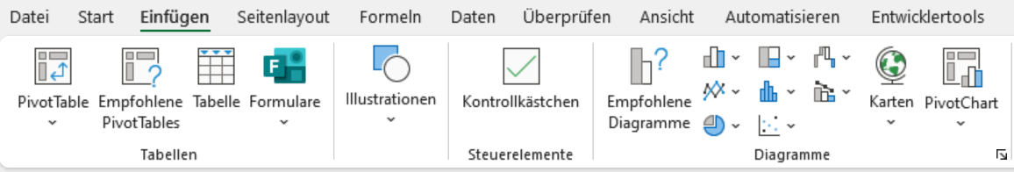
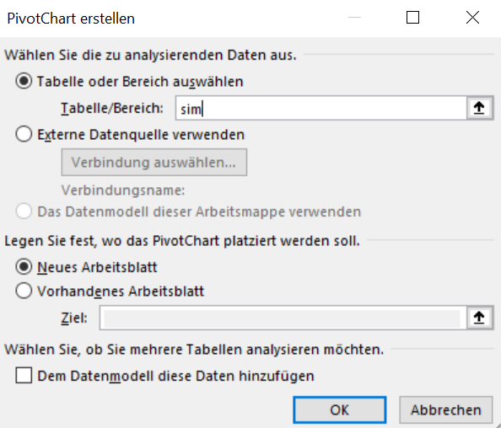
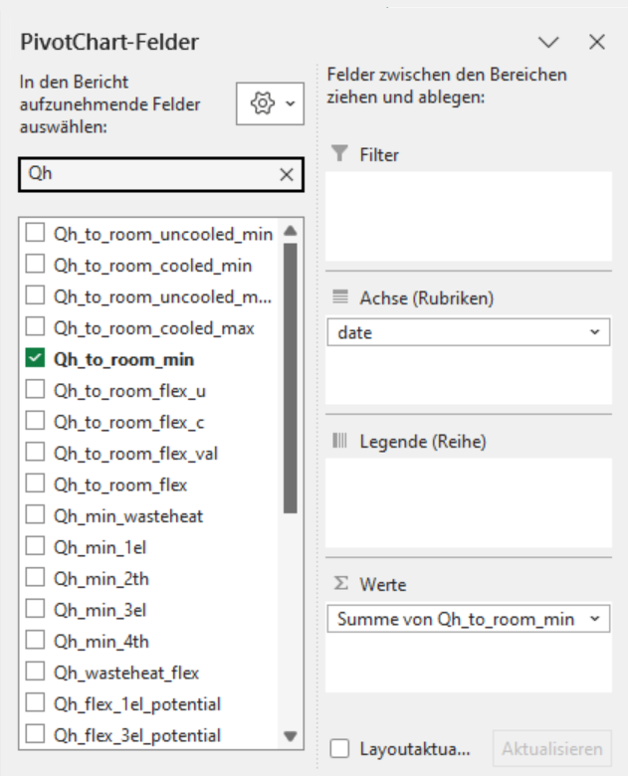
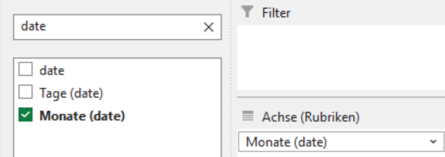
Eigene Auswertungen
Tabelle „sim“ im Blatt „sim2“ enthält alle stündlich vorliegenden Variablen
Diese Werte werden am besten mittels PivotTabelle und/oder PivotChart referenziert:
Gewünschte Aggregation einstellen
Stündlich „date“
Täglich „Tage (date)“, > Wertfeldeinstellungen der Werte: Summe / Mittelwert
Monatlich „Monate (date)“, > Wertfeldeinstellungen der Werte: Summe / Mittelwert
Variablen Suche / Auswahlfilter
Stündlich
Gewünschte Vars in „Werte“ ziehen

Slide 40
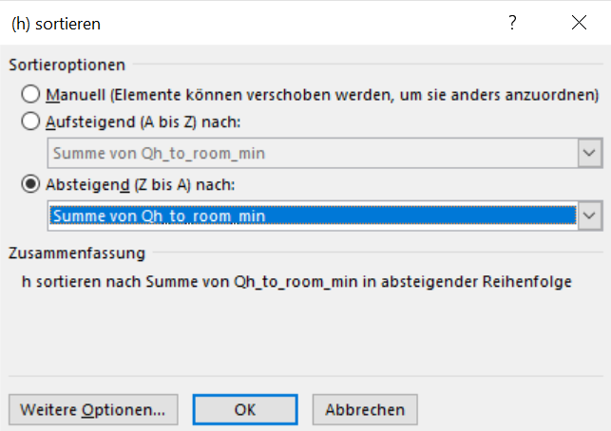
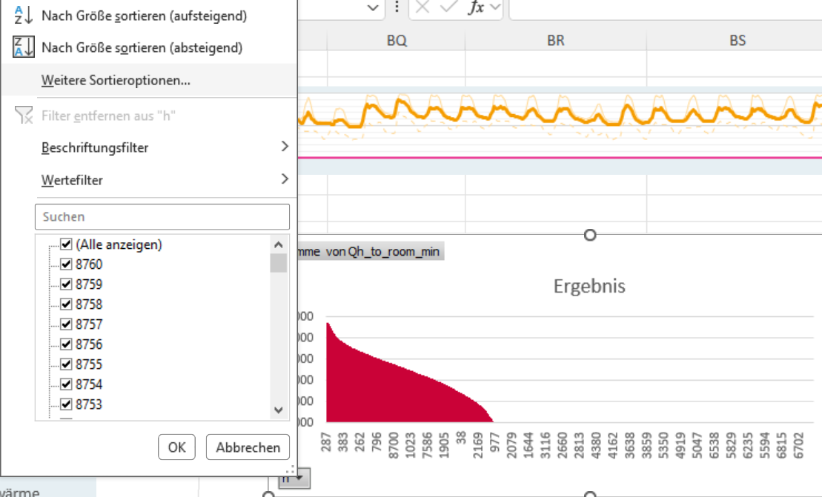
Jahresdauerlinie

Slide 41
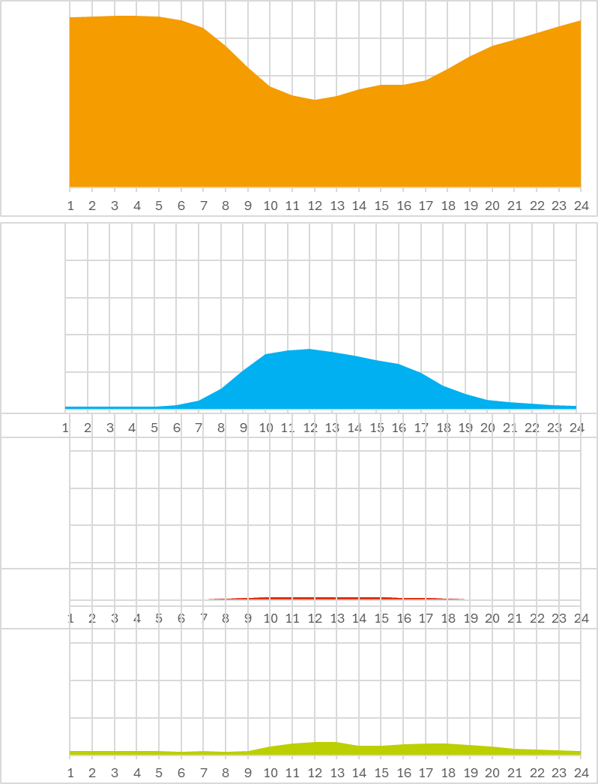
🚗Mobilität: Überblick
Positive Energy District
with mobility
Gemäß Definition wird in PEQ+M und knPEQ nur MIV berücksichtigt
MIV wird auf 2 Arten berücksichtig
jahresbilanziell in der PEQ-Bewertung wird nur der 🎯Zielverkehr zum Quartier, sowohl ⚡elektrisch als auch 🛢fossil berücksichtigt
stündlich für flexiles DSM werden Alle im Quartier verkehrenden ⚡ E-Autos und Ihre Verkehrsleistung berücksichtigt
von BewohnerInnen, und NutzerInnen von Büro/Bildung/Einkauf
Das Quartier kann damit „fremdes“ Verkehrsaufkommen mitdecken
Bi-Direktionales Laden erhöht Speicherkapazität
Local renewable energy sources
EVs in the district
Residential
Work
Education
Retail&Shopping
Zielverkehr
Anderer Verkehr

Slide 42
🚗reale vs bilanzieller Energiebedarf
Verfahren und potentiell geladen/gedeckt kann beides werden: Ziel- und Quellverkehr.
Deswegen sollte auch beides, also der gesamte Verbrauch dynamisch berechnet werden
EE > Zielverkehrsbedarf.
Bilanz PLUS
Bedarf Quell-Verkehr
Deckung Netz
EE < Zielverkehrsbedarf.
Bilanzminus
+
Deckung Flex
Deckung Quellverkehr Entspricht einem Export von Erneuerbaren
Bedarf Ziel-Verkehr
Bedarf Ziel-Verkehr
-
Netz
Bedarf Ziel-Verkehr
Deckung PV gridsub
Deckung PV gridsub
Deckung PV gridsub
Deckung Flex
Deckung Flex
Bilanziert wird nur der Zielverkehr
geht in PE-und THG Bilanz ein:
Netzbezug
PE-und THG relevante Emisisonen:
VRgrid_ev + PVev - Zielbedarf

Slide 43
🚗reale vs bilanzieller Energiebedarf
Verfahren und potentiell geladen/gedeckt kann beides werden: Ziel- und Quellverkehr.
Deswegen sollte auch beides, also der gesamte Verbrauch dynamisch berechnet werden
Netz
bidi
Externes Laden
Nutzer-
strom
EE > Zielverkehrsbedarf.
Bilanz PLUS
Bedarf Quell-Verkehr
EE < Zielverkehrsbedarf.
Bilanzminus
Deckung Netz
+
Deckung Flex
Deckung Quellverkehr Entspricht einem Export von Erneuerbaren
Bedarf Ziel-Verkehr
Bedarf Ziel-Verkehr
-
Netz
Bedarf Ziel-Verkehr
Deckung PV gridsub
Deckung PV gridsub
Deckung PV gridsub
Deckung Flex
Deckung Flex
Bilanziert wird nur der Zielverkehr
geht in PE-und THG Bilanz ein:
Netzbezug
PE-und THG relevante Emisisonen:
VRgrid_ev + PVev - Zielbedarf

Slide 44
Statistischer Mobilitätsbedarf
Floorspace / StatPAX
JPkm per Mileage
Zielverkehrsanteil
EV Verbrauch kWh/km
CF Grid Bezug
Floor spaces per Usage
StatPAX
Statistische JPKM MIV Fahrer
Bedarf: Zielverkehr Statistisch JPkm als Fahrer
EE-Energiebedarf Elektrisch
PE-Bedarf Elektrisch
EE-Energiebedarf Fossil
CF Fossil
EV Anteil
PE-Bedarf Fossil
Reale EV Speicher und Ladebedarfe
Quartiers-ferner Verkehr
Deckung Extern
Cars / Usage
EVs
Jährlicher Ladebedarf pro Auto / Nutzung
EVs residential
Deckung Intern Netz
EVs Work
Ecar Ladeverluste
Bedarf Entladung Ecar
Deckung Intern PV
EVs Shopping
Bedarf Zielverkehr
Deckung Intern Flex
Quartiers-Bedarf
Ecar Entladung Ecar

Slide 45
Statistical Mobility Energy demand district responsibility
Floorspace / StatPAX
average MIM Mileage at district location
% Destination travel
Energy use intensities [kWh/km] fossile/electric
Hourly Primary Energy intensity Grid
Hourly GHG intensity scenarios
Floor spaces per Usage
„Averagely mobile“ Persons per Usage (AMPU)
Average annual MIM mileage per Person
Demand: Zielverkehr Statistisch JPkm als Fahrer
Electric Energy end use electric
PE-Demand Electric
GHG-Emissions Electric
EV share
Fossile Energy end use electric
PE-Demand fossile
GHG-Emissions Fossile
Actual EV charging and storage potential
Quartiers-Bedarf
Mobility use: Total annual charge per EV per usage
Offsite mileage
Offsite grid charging
Cars / Usage
EVs
EVs residential
Onsite grid charging
EVs Work
Charging losses
EVs Shopping
ED destination mileage
PV charging
storage use
EV discharge as district energy source
flexible grid charging

Slide 46
External data input
Average Floorspace per AP_{u} (O_{u}, Table 2 [3])
Average Mileage at district location per Person (M,Table 2, [3])
Distribution of trip to destinations residential, work, education, retail
(p_{u},Table 2)
Hourly location profiles (d_{u}, a_{u}, l_{u}, r_{u}, Table 3)
Energy use intensities [kWh/km] fossile/electric
Model Parameters
Hourly Mobility Energy Flows
„Averagely mobile“ Persons per Usage (AP_{u})
Annual total Mileage per destination (AM_{u})
Annual total Mileage per Vehicle (AMV_{u})
Floor spaces per Usage (A_{u})
Electric Vehicles per usage (N_{u})
Hourly location of Vehicles
District Location
APU Simultaneity (s_{u})
MIM EV share (f_{EV})
Vehicles per Usage (v_{u})
Hourly Building Simulation
District specific Inputs
Factor for Mobility Measures (f_{mm})
Charging Infrastructure (P_{infra})
Setpoints
EV capacities

Slide 47
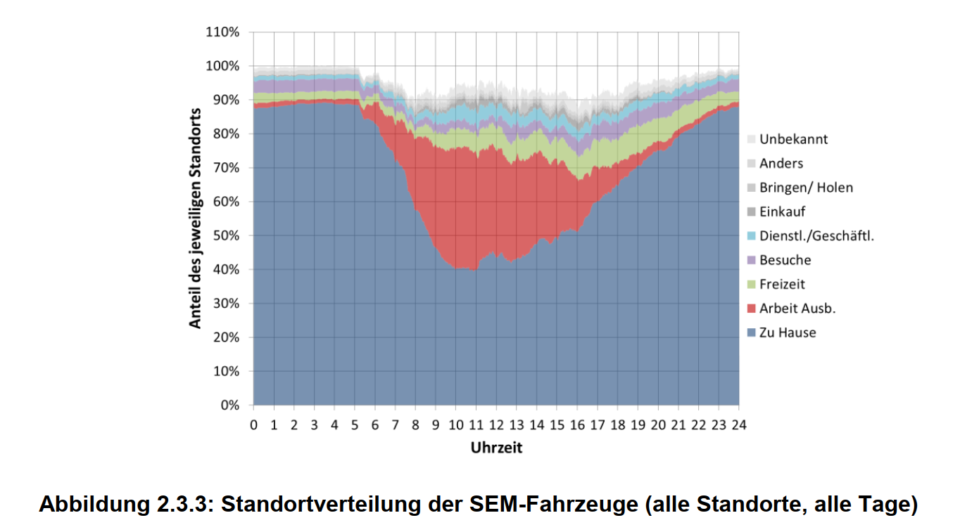




Method
Hourly profiles for
Weekday, Friday, Saturday, Sunday
Annual
Annual Mileages per Person
At which location/usage is a Vehicle per Person?
Given a floor usage, how many people/cars will there be
Floor spaces per Usage
Floor spaces per Usage

Slide 48
Energy flows
Fleet Presence
Positive Energy District
with mobility
Local renewable energy sources
EVs split in 2 Groups:
„present“
„away“
EVs in the district
Residential
Work
Education
Retail&Shopping
Share of Cars
Present
Away

Slide 49
🚗Mobilität: Verkehr vs Speicher
Positive Energy District
with mobility
Kann „besser als mit Netzstrom mitgedeckt werden“
Speicher = Cars * specific cap
Muss gedeckt und bilanziert werden, mit Gutschrift
Zielverkehr
Anderer Verkehr

Slide 50
Bilanzierung Balancing
Import
Export
Priorisierung der Bedarfsdeckung
Prioritization of demand coverage
Mit🚗bidirektionalem Laden
PV Überschuss
Export
PV Excess
Export
Bedarfe
Demands
Nutzerstrom
HT Minimum
E-Car Minimum
Ladezustand
HT Maximum
E-Car Maximum
Ladezustand
Elektrische Batterie
Plug-loads
HVAC & DHW Minimum
HVAC & DHW
Maximum
Battery
Electric Vehicle
Minimum Charge
Electric Vehicle
Maximum Charge
Deckungen
Supplies
Lokaler PV-Strom
Local PV production
Elektrische Batterie
Flexible Charging of
thermal and electric storages
Battery
Externe Erneuerbarer Überschuss
(DSM, Wind-Spitzen)
Offsite Renewable Excess
(DSM, Wind Peaks)
E-Car Maximum
Ladezustand
Electric Vehicle
Maximum Charge
Stromnetz
Systemgrenze
System Boundary
Electricity Grid
Mindestbedärfe gedeckt
Minimum demands met

Slide 51






Bilanzierung Balancing
Mit🚗bidirektionalem Laden
Import
Export
PED Balancing System Boundary
EV
Minimum
Charge
EV
Maximum
Charge
Prioritization of demand coverage
Demands
Plug-
loads
HVAC
DHW Minimum
HVAC
DHW
Maximum
Battery
Supplies
Local PV production
Flexible Charging of
thermal and electric storages
Battery
Offsite Renewable Excess
(DSM, Wind Peaks)
Electric Vehicle
BiDi Discharge
$$E_{ev>pl}$$
$$E_{ev>hvac}$$
$$E_{D}\left(t\right)$$
$$E_{Cflex}\left(t\right)$$
$$E_{Cmin}\left(t\right)$$
Electricity Grid
External Charging
offsite the district
$$E_{Cext}\left(t\right)$$

Slide 52

Datenerhebung
Anteil [%] des jeweiligen Aufenthaltsortes von Fahrzeugen
Großteil zuhause
Zweitgrößter Anteil des Standortes Arbeit Ausb.
Maximum 10:00
Die Bewegung der Fahrzeuge ist die Fläche zwischen grauen Bereich und 100%
Notes:
Interessante Datenerhebung.
Aus diesen Daten wurden die Fahrprofile für das Wochenende abgeleitet.

Slide 53
🎯 | Zielwert, Grenzwert und THG-Budget
 | Das CO₂-Budget basiert auf dem Konzept der planetaren Belastungsgrenzen und der international anerkannten Zielvorgabe, die globale Erwärmung auf 1,5 °C zu begrenzen. > Zur Erreichung mit min. 66% Wahrscheinlichkeit ergibt sich daraus auf alle Menschen gleichmäßig verteilt ein global verfügbares Netto-Restbudget von 14,5 t_{CO2eq}/Pers. > Zusätzlich führen jährlich natürliche THG-Senken von 1 tCO2eq/Pers in den nächsten 50 Jahren zu einem Brutto-Restbudget von inssgesamt 14,5 + 50 = 64,5 tCO2eq/Pers . Bezogen auf die österreichische BGF beträgt das > Netto dem Zielwert von 72 kg_{CO₂eq}/m²_{BGF} ohne natürlicher THG-Senken (die ja schwinden) und > Brutto dem maximalen Grenzwert II von 320 kg_{CO₂eq}/m²_{BGF}, inklusive natürlicher THG-Senken von 1 tCO2eq/Pers

Slide 54
🌳 | Bewertung der Co2-Speicherung in Baustoffen
 | Für die Berücksichtigung der CO2 Speicherung in Baustoffen aus nachwachsenden Rohstoffen und die Bewertung der Treibhauswirkung in Abhängigkeit des Zeitpunkts der Emissionen kann ein vereinfachtes Verfahren oder ein dynamisches Verfahren angewendet werden: Beim vereinfachten Verfahren wird das Modell „aspern klimafit 2.0“ herangezogen, das die temporäre CO₂-Speicherung als Klimaschutzmaßnahme anerkennt. Dabei gilt: 🌾 Für pflanzliche Baustoffe mit kurzer Umtriebszeit (z. B. Hanf, Flachs, Stroh) werden 100 % des biogenen Kohlenstoffgehalts als CO₂-Speicher angerechnet. 🌳 Für Holz mit längerer Umtriebszeit wird nur jener Anteil des Kohlenstoffs angerechnet, der über eine nachhaltige Waldbewirtschaftung hinausgeht, also zusätzlich zur natürlichen CO₂-Senkenleistung eines ungenutzten Waldes. Dieser wird konservativ mit 55 % des biogenen CO₂-Gehalts bewertet (25 % Kalamitätenholz + 30 % zusätzlicher Biomasseaufbau)​ 🌲🪓 Holzprodukte, die nachweislich aus Bäumen mit Borkenkäferbefall, Windwurf etc. stammen (Kalamitätenholz), werden mit 100 % des biogenen CO2-Speichers berücksichtigt. Das alternative dynamische Verfahren bewertet die CO₂-Emissionen zeitlich differenziert über den Lebenszyklus – also mit dem Ziel, den Strahlungsantrieb des Klimasystems zu senken. Dabei wird berücksichtigt, dass eine verzögerte Freisetzung von CO₂ eine geringere Treibhauswirkung hat als eine sofortige Emission.

Slide 55

Netzdienlichkeit CO2eq
Operationalisierung CO2eq aktuell und Szenarien 2025, 2030, 2040, 2050
Treibhausgasemissionen des österreichischen Liefermixes:
Liefermix gemäß OIB Richtlinie 6 2015 276 g CO2,eq/kWh, OIB 2019 227 und OIB 2023 156 g CO2,eq/kWh)
Startpunkt der Kurven 2016 bis 2022 (jeweils 1.9. des Vorjahres bis 31.8. des laufenden Jahres) gibt den THG Ausstoß für den Betrieb der Energiebereitstellung von elektrischer Energie an
2030 und 2040 Szenarien (UBA 2023), 2025 interpoliert,
2050 Energiesystem klimaneutral auf Grundlage Streicher 2050 „Österreich energieautark“ adaptiert (Schöfmann 2022)

Slide 56

Netzdienlichkeit Österreich aktuell, Zielfunktion CO2
Kenndaten Entsoe, bzw. Electricity map
Große Schwankungen zwischen Sommer und Winter, aber auch zwischen den klimatischen Rahmenbedingungen
Leistungen im Hochwinter höher und stark von Importen abhängig
Daten inkl. Klimadaten und die Szenarien des UBA für 2030, bzw. Streicher 2050 adaptiert sind die Basis Erstellung

Slide 57
Dynamische CO2eq Intensität und Klima
Operationalisierung SRI Demo
CO2-Intensität Stromerzeugung:
2025 hochgerechnet aus Profilen 2016 bis 2022
2030 (Österreich Stromversorgung bilanziell 100% erneuerbar)
Basis Kenndaten electricity map und Szenarien UBA für 2030
Netzdienlichkeit Österreich 100% erneuerbar
2040 „Österreich energieautark 2050“ laut Streicher 2011 adaptiert Mobilität und Geothermie mit UBA 2017 transition (Schöfmann 2022)
Klimadaten
Klimadaten 2016 bis 2022 laut GeoSpere
Quelle: UBA 2023

